Slide 1
Improving Website Accessibility with Siteimprove
Jenn Dandle / Joshua Hori / Mary Salome / Eric Mayes / Tyler Vogel
http://lib.ucsd.edu/si-uccsc18
UCCSC 2018 at UC Davis
August 14, 2018
Notes:
Short link for this presentation: http://lib.ucsd.edu/si-uccsc18
---
Conformance with accessibility standards is essential for allowing users of diverse technologies to access and interact with information on their computer, in apps, and through online sources.

Slide 2
The Presenters
Who We Are
Jenn Dandle: Web Manager, UC San Diego Library, SiteImprove Local Admin
Joshua Hori: Accessible Technology Analyst, Student Disability Center, UC Davis
Mary Salome, MA: Production Manager, UCSF Center for HIV Information
Eric Mayes: UI / UX Developer, UC Santa Barbara, Student Information Systems & Technology
Tyler Vogel: Digital Communications Project Manager, UC Davis Health
Notes:
4 UC Campuses collaborated on this presentation, integrating a bit from each of our campuses experiences with the Siteimprove implementation
Intro - Josh
User Adoption - Mary
Improvement Process - Tyler
User Guidance and Solutions - Jenn
Current and Future Challenges - Eric / All

Slide 3
Notes:
Why are we here talking about making websites more accessible? What’s that got to do with skateboarding?
Photo credit: Izabella Sekowska-Bacalski
[Jenn] My friend Josh is helping me learn to skateboard. The progress I’ve gained since beginning is nothing short of a miracle. Things would have been over before they began if the exercise hasn’t been adapted for my ability and learning style. I regularly and often get to experience what it feels like to perform feats I’m not actually able to do on my own [yet], as you see in this picture. We’re doing a run with him “guiding” me. I’m able to fully participate in skateboarding because of the support for adaptation and assistive tech (AT) provided by my friend and coach.
When we keep accessibility in mind and work to ensure websites and contents are accessible, we’re making it possible for users of all abilities to fully participate in the web… by providing support for the assistive technology and adaptation some users may need for experience.
Video: https://www.instagram.com/stories/highlights/17957844856058913/

Slide 4
Getting Started
Definitions
Web Accessibility
Siteimprove
Web accessibility focuses on how to make Web content more accessible to people with disabilities, including visual, auditory, physical, speech, cognitive, language, learning, and neurological disabilities.
SiteImprove cloud-based software - now available at all UC campuses - provides services that help improve content quality, work towards accessibility compliance, drive search engine traffic, meet data privacy requirements, and measure website performance and ROI—in a single platform.
Notes:
Not an in-depth training on accessibility or a demo of SiteImprove, this is an overview of user adoption, improvement processes, and current and future challenges involving Siteimprove
Making things accessible makes them better for everyone, and the Web Content Accessibility Guidelines help do just that for the web
Web Content Accessibility Guidelines (WCAG) –
The WCAG documents explain how to make web content more accessible to people with disabilities. Web “content” generally refers to the information in a web page or web application, including:
natural information such as text, images, and sounds
code or markup that defines structure, presentation, etc.
https://www.w3.org/WAI/standards-guidelines/wcag/

Slide 5
Getting Started
About this presentation
Accessibility Resources
Related Sessions
UCOP Electronic Accessibility
SiteImprove Webinar: Let's Discuss Accessibility and the Updates to WCAG 2.1
August 21, 10 a.m. – 11 a.m.
Learn to Use the Siteimprove Web Accessibility Review Tools
2 p.m. – 2:45 p.m.
RMI Conference Room – 1207
Notes:
Not an in-depth training on accessibility or a demo of SiteImprove, this is an overview of user adoption, improvement processes, and current and future challenges involving Siteimprove
Resource Links:
UCOP Electronic Accessibility: https://www.ucop.edu/electronic-accessibility/
Let's Discuss Accessibility and the Updates to WCAG 2.1: https://siteimprove.com/en-us/events/webinar-improve-your-government-website-with-analytics-and-user-experience-testing-1/
Learn how to Use the Siteimprove Web Accessibility Review Tools: https://uccsc.ucdavis.edu/sessions/learn-use-siteimprove-web-accessibility-review-tools

Slide 6
Why this Presentation?
We want to help UC Campuses:
Increase adoption of SiteImprove
Provide web staff a clearer path forward with resolving accessibility issues
Navigate the vast journey of improving the web

Slide 7
User Adoption
Adopt Me!
Notes:
Photo credit: https://pixabay.com/en/cat-kitten-black-animal-pet-kitty-907749/
If you have ever used browser-based tools to evaluate compliance with accessibility standards one page at a time, especially on large or complex sites, you are going to want to adopt this kitten. Not to knock the free tools, I'm very grateful for them. It's just that SiteImprove is a really, really good kitten.
That said, there’s plenty of work to be done to get to the user adoption stage.

Slide 8
User Adoption
Setup and Integration: Locating Sites and Adding them to SiteImprove
Ensuring the crawl is accurate
Modifications to site templates to support enhanced features of SiteImprove
Comparing data in SiteImprove with data from other systems
Providing development teams a project plan for rollout
Notes:
Accuracy:
Ensuring the crawl is accurate. If you’re familiar with your stats from other Analytics tools, or just have a feel for how much content is on your site, you’ll be able to tell if things seem off in your reports.
We noticed that on one of our sites (aidsetc.org) there were duplicate entries for all the broken links, one with “www” prefix and one without.
We also noticed some urls where each valid query string combination was included, so one page was listed several times slightly differently.
This meant that each isse was listed twice, and that the total pages count was also elevated.
We were able to work with SiteImprove support to remove the listings starting with www from our reports, and to strip out the query and everything after it.
After the changes, the site report went from listing 18,000 “pages” to 3,000.
Originally there were more than 1,000 pages with broken links before, and that dropped to 250.
Their support was very responsive -- fast and attentive. This is a partnership between UC and SiteImprove as a vendor. Keep the lines of communication open and make sure they are invested.
Enhanced features of SiteImprove
Hit counts
First, identify your Campus Siteimprove Administrator, Web Standards Program Manager (UCSF), Electronic Accessibility Committee (EAC) representative, or someone in a similar role. That person will add your web sites to be scanned by Siteimprove. I'll call them your Point of Contact for short. That person will need a list of your sites, and the users who will need to access reports. Siteimprove users can be outside of UC -- contractors or partners in other agencies, for example-- as well as faculty, students and staff.
Users need to log in once, and then your Point of Contact can configure their accounts so they access the reports for the sites they work on. Your PoC can’t associate users to sites that have not finished their initial crawl.
Siteimprove will automatically scan your sites weekly. You can run manual scans at other times if necessary. If you don’t see a manual recrawl option on our dashboard where the documentation suggests it would be, it's likely because your role doesn't have access to it. In that case open a ticket with Siteimprove support to get their help.
Once you're set up, create a plan for managing the fixes that are indicated in your reports. You'll want to prioritize the fixes based on a variety of factors. Siteimprove makes it easy for you to use the number of pageviews as a factor in prioritizing, and to do that you add a snippet of JavaScript just before the end of your HTML output.
Pro Tip: You use the same snippet for all your sites. There isn't a unique snippet for each site.
If you have a website that is managed by your IT group, they might have done this for you. If you're not sure if it's done, view source and search for the word siteimprove. If you see it near the bottom of the HTML, you're all set.
When the priority script is added you'll see numerical values instead of question marks in the Page Views column under any single Accessibility Issue in your reports.
Deep Linking
It is possible, with some content management systems, for the report to link directly to the edit screen for the page where an issue was found. It's done through a process they call deep linking. It works with WordPress and Drupal, but probably not older or proprietary CMS’s. You need to add a meta tag to each page with the unique ID for the page, usually a node or taxonomy ID if you're using Drupal. It saves some clicks and some time, so it a little more convenient. You must be logged into the site in question and have proper privileges there in order for it to work.
Development Team project plan: configure, test, confirm data accuracy, create user documentation
SiteImprove Analytics Module [not included in UC contract]: comparing data to GA or other analytics data
Development Team project plan: configure, test, confirm data accuracy, create user documentation

Slide 9
User Adoption
Generating Awareness
Make accessibility a commonly recognized term in your web communities
Ask for input from actual users; students demonstrate use of AT
Wow your users with some quick wins to get them excited about using the tool
Notes:
Accessibility as a commonly recognized term: include in trainings, user guides, design and content processes
Build time into your planning
Create or solicit organizational support
Remind yourself that it's the law
Consider the ways being more accessible is good for the University, your group, and all users
Recall the people on the other side of the screen
SI Browser Extension
Firefox: https://addons.mozilla.org/en-US/firefox/addon/digital-certainty-index/
Chrome: https://chrome.google.com/webstore/detail/siteimprove-accessibility/efcfolpjihicnikpmhnmphjhhpiclljc

Slide 10
User Adoption
Quick Wins
Identify and correct broken links and misspellings
Use the Site Inventory feature to identify links and media
Beginning with QA tools will help reduce cognitive load when moving into accessibility tools
Check out the SiteImprove Accessibility Checker browser extension
Check the accessibility of pages with sensitive data
Notes:
The developer for Special Collections at the UC San Diego Library corrected links referring to paths from 4 redesigns ago or so
Users might be surprised by the number of quality issues reported in their sites but will swiftly move into fix-it mode
Remind staff that it’s not about the number of issues in the reports or comparing their reports with other sites
Comparing sites isn’t “apples to apples”
Instead focus on the improvement to quality and user experience and measuring progress over time within the same site.
There are people with a lot to offer our communities who want to contribute and engage. SiteImprove and tools like it make it possible by helping us make our content accessible. Our communities are worth the effort.

Slide 11
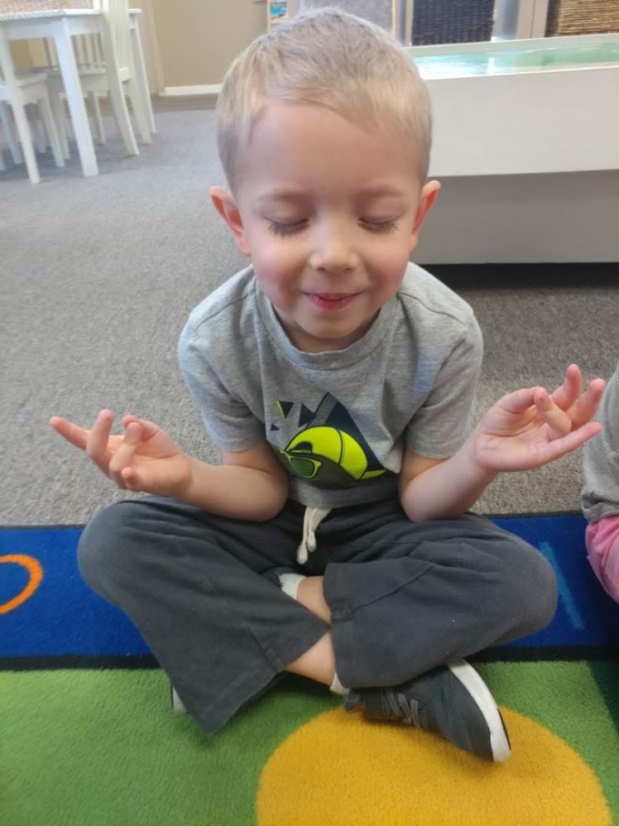
Improvement Process
Envision success!
Notes:
Presenter: Tyler Vogel, Digital Communications Project Manager at UC Davis Health.
This is my son Elliott earlier this year at age 4 in preschool. Visualization helps us envision success, reduces cognitive overload.
UC Davis Health: Siteimprove since October 2014. We also pay for the analytics module. As of August 8, 2018, Siteimprove’s accessibility crawl counted ~8,800 pages in our public site domain. Our team trains and enables ~ 600 web editors, ~150 public sites, which includes guiding accessibility improvements. Using CMS OpenText Teamsite.

Slide 12
Improvement Process
Tips on getting started
Partner with others to help organize, divide, and conquer
Start with one issue or one page
Prioritize WCAG A/AA issues to comply with Section 508
Notes:
Helps if we can share the load/opportunities. Partner with CMS administrators, front-end and back-end developers, project managers, editors, trainers, other UCs, Siteimprove, to learn from on another and share the workload. UC Davis Health Digital Communications recently partnered with a unit in our institution, Public Health Sciences (editorial / developer staff members Victoria Sharpnack and Cornell Wade) to sort through flags, identify solutions, etc.
If you’re feeling overwhelmed, begin with one issue on one page and go from there
Label is not connected to a form control (search box field)
Section 508 was added as an amendment to the Rehabilitation Act of 1973 in 1986 - requiring Federal agencies to make their electronic and information technology accessible to people with disabilities

Slide 13
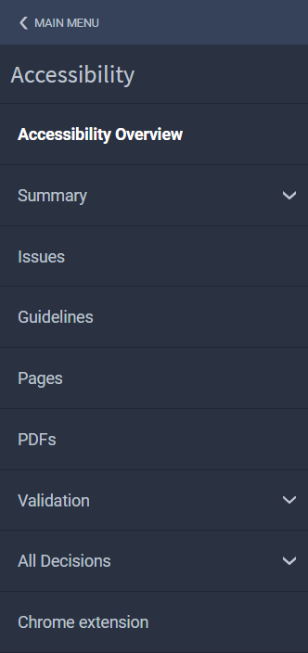
Improvement Process
Accessibility score and reports
Note initial accessibility score
Reports
Accessibility score breakdown
Issues
Download for tracking purposes
Pages
Siteimprove Accessibility Checker - Chrome browser ext.
accessibility menu
Notes:
Accessibility score breakdown report: (Accessibility Overview > Score Breakdown)
Listing of A, AA, AAA errors
Focus on improving the score - helps keep folks motivated and ‘rewarded’
Try not to compare with others - we’re all working under different circumstances
Issue report helps get a handle on all issues, some of which may be common across pages.
Pages report helps us gives us a pages view of our site
Siteimprove Accessibility Checker - Chrome extension allows a scan of pages on intranet/not live yet/not available in production environment

Slide 14
Improvement Process
Organize, prioritize and assign issues
Group issues report into template-level and page-level sheets
Customize report for progress tracking (example of custom fields):
Issue Description | Page report link | Solution | Owner | Completion (Y/N)
Assign owners to issues and pages reports; identify and implement solutions
Notes:
Context: UC Davis Health developed this process for rollout to 300+ web editors. Depending on your role and your team’s software preference, the process and tools you choose may vary. For example, you might choose to use JIRA, Trello or another project management tool to handle task assignment.
Issue report helps us get a handle on all issues, some of which may be common across pages.
Conformance level (A…) | Severity Level (Errors, Reviews, Warnings) |Success Criteria | Description | Pages | Responsibility | Completion | Progress |
| Title | URL | Occurrence | Page Views | Page Level
Add columns for solution/next steps, confirmed in production, etc.
The report can be filtered in SIteimprove by Webmaster, Developer, Editor or general
We grouped the issues by template-level issues (handled by UI/UX and technical lead in Digital dept.) and prioritized these first, specifically targeting A AA. Because these roles are internal to our team, we assigned tasks via Trello card while maintaining the spreadsheet as well.
We assigned page-level issues to unit editors via the custom spreadsheet and provider solution to issues that they needed guidance on. Notes: this is our approach to task management considering that individual-/account-level task assignment doesn’t yet exist. Account members can be assign the role of editor, webmaster or developer, and issues can be filtered/reassigned to roles.
Pages report helps us address issues page-by-page.
Title | URL | A | AA | AAA | Page views | Page level
Reports can be filtered in a number of ways
- Page traffic (default)
- Single A or double AA issues
-"Points to be gained"
- Page levels (1,2,3)
There is currently no way to assign issue to individual Siteimprove account, but the functionality has been identified as a future release item

Slide 15
Improvement Process
Track progress
Track progress via issues report, pages report, and accessibility score
Connect with Siteimprove support if issues arise
Platform-level and page-level sync bug: some issues aren’t dropping from issues listing; Siteimprove is working on a fix
workaround: mark fixed issues as ‘can’t fix’ or ‘refresh’ pages so the issues will drop from total score and issues report
Notes:
Check score ~2x a month to see if/how score is improving
Siteimprove confirmed accessibility crawl (platform-level vs page-level) has issues - working on fix by end of this year, early 2019.
Nick Dalman - account manager
Next presenter: Jenn Dandle from UC San Diego

Slide 16
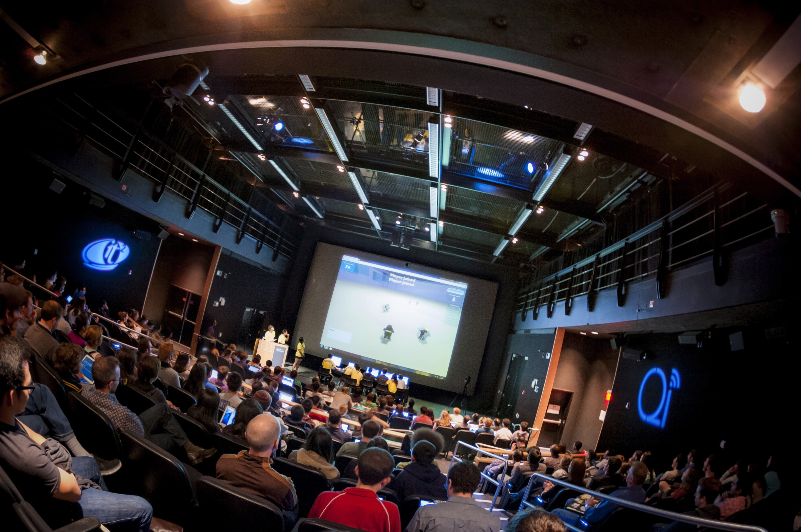
User Guidance & Solutions
Notes:
Shepherding the change management process...

Slide 17
User Guidance & Solutions
Making it easier for users to adopt SiteImprove
Leverage awareness strategies to drive interest
Manage the change process
Simplify and provide specific relatable context for complex concepts
Connect existing knowledge to new knowledge to foster understanding
Notes:
Managing the emotions related to the work
“We’re not here to tell you how awful you are or how wrong everything is…” Want to share how using this tool helps improve
“I inherited this”, “I didn’t know”, all of this is fine… exercise isn’t meant for a blame game
Keep it simple
Start with the tangible -- broken links/QA
Use Groups and filters to reduce cognitive load
Leverage CMS deep linking when possible
Provide specific context for usage
Small group/1-1 means we can tailor the overview specific to the work of the person who is being trained

Slide 18
User Guidance & Solutions
SiteImprove Onboarding for UC San Diego Library
Introduce SiteImprove in context of other web work
1-1 or small group meeting / ~ 30 minutes
Works well face-to-face or via Zoom
Help assuage the stress of “one more thing to do”
Notes:
Format easily adapts to users of all skill levels. Features highlighted in session should vary based on the role of the user.
Most library website contributors are not technical… the focus for non-technical is especially on QA and content accessibility (well-formed hyperlinks, appropriate heading usage, good alt text)
Library Special Collections has a developer who isn’t included in Library ITS. His onboarding was tailored to correcting accessibility and other QA issues related to finding aids (templates).

Slide 19
User Guidance & Solutions
1-1 Session Overview / SD Library Users
What to expect?
Features
Quality Assurance (QA): Links → Pages with Broken Links, Links → Broken Links
Accessibility → Issues; filtering to reduce cognitive load
Accessibility → PDFs
Policy: Locating all instances of specified conditions in site
Notes:
What to expect
Logging in
User interface
Getting help (training, questions, future consultations)
Features -- Where to find them and how to use them
Quality Assurance:
Links → Pages with Broken links
Links → Broken links
Links → Broken links -- Filter by status code (404). Others may be false positives
Misspellings -- Mention this
Accessibility → Issues
Filtering to reduce cognitive load
Select “Editor” role and “Conformance”
Accessibility → PDFs
Policy: Describe how policies can be used to find all instances
“Click here” hyperlinks
Branding → Don’t refer to UCSD, instead use UC San Diego.

Slide 20
Current and Future Challenges
Ever evolving standards
Tool adoption
Partnerships
Training
Culture Change
Diverse technologies and platforms
Notes:
Web Standards and Accessibility standards are always evolving, its just the nature of this kind of work. We need to keep up, and evolve along with them. Some techniques used in past years are no longer needed today, resulting in lower Siteimprove scores right off the bat.
example : aria landmark roles
Tool adoption - The main philosophy of UCOP’s implementation team is that roll out isn't going to be quick and it's best we train those who we can versus onboarding the entire campus at once. But Siteimprove is very easy to learn, and very educational as well. Someone with little to no coding knowledge can use and understand this tool. Most departments have no dedicated personnel to maintain their sites, so having something like Siteimprove is very beneficial.
Partnerships – Again we need to somehow create partnerships between front-end and back-end developers, project managers, editors, trainers, other UCs, and Siteimprove, to learn from one another and share the workload
Training - We need the advocates and leaders in accessibility at each campus to help spread their knowledge and passion for accessibility, providing guidance to other developers and content managers. We also have a bunch of training videos available from Siteimprove, who also provide a community forum, a great place to ask questions and get solutions. And they have been super responsive
Culture change - to create a culture change around accessibility, we need to find opportunities to spread accessibility knowledge and enthusiasm, and we need to reward accessibility champions. Developers need to make it part of their process up front, and content editors need to keep it in mind as well. Finding time and resources to keep this afloat
We also need to support emerging user experiences - Augmented Reality etc

Slide 21
Recap
To succeed with Siteimprove
We need to get users into the system
Learn the Improvement Process
Provide User Guidance and Solutions
Identify our challenges into the future
Notes:
We need to get users into the system and start getting quick wins by fixing the simplest errors first
We need to partner with others and fix issues in a strategic fashion
We need to relieve the stress of increased staff workload
And we need to identify and plan for our challenges into the future

Slide 22
Support
Resources
UCTech Slack - http://uctech.slack.com/
#siteimprove channel
UCOP SiteImprove: https://www.ucop.edu/electronic-accessibility/web-developers/tools-and-testing/siteimprove/
SiteImprove Learning Academy and Community Forums
Notes:
There will be a systemwide notification as soon as its time to start using the tool
UCTech Slack - UCOP has recently purchased a systemwide license for the team communication tool “Slack”, which enables real-time collaboration between IT professionals both locally and between UC locations

Slide 23
Thank You
and remember to always keep Accessibility in mind!
THeThe

