Slide 1
UCPath On MuleSoft Anypoint Platform
By
UCOP - TDS

Slide 2
UCPath – quick intro
Replace and consolidate multiple PPS instances
Harmonize HR and payroll processes
PeopleSoft HCM
Hosted at OMCS (Oracle Managed Cloud Services)
Multiple integration points, files and webServices

Slide 3
Organizations served
Production
UCOP
UCLA (UCPath IDM interfaces)
UCR
UCM
ASLA
External Vendors
Salesforce
Glacier
Data Center Apps(SD)
FileNet
AYSO
TCS
UCRS
Pre-Production In-progress
UCLA Tracker
UCSB Universal
UCSF
UCSD
UCSC
UCH
UCBLAB
UCD
UCB
ANR
UCI

Slide 4
Current UCPath Web Service Interfaces
Interfaces | Type | Vendor | Campuses
E-017 -FileMonitoring | Inbound |  | UCPC
I-107 Seperated Employees | Inbound |  | UCOP IDM
I-165 Employee Security | Inbound |  | All
I-186 Employee Security | Inbound |  | All
I-262 Custom UCID/Email/Phone | Inbound |  | All
I-371 Trigger I280 | Inbound |  | All Campuses
I-606C FileNet | Inbound | FileNet
E-044B JobTitle | Inbound | TCS
I-619 Taxation | Inbound | Glacier

Slide 5
Current UCPath Web Service Interfaces
Interfaces | Type | Vendor | Campuses
I-280 Person Data change | Outbound |  | All
I-606A Address/Benefits/Job/PersonData changes | Outbound | Salesforce AYSO
I606B Address Change | Outbound | AYSO
I-370 FS Combo Code Validation | Outbound |  | UCLA UCR
I-367 Department Updates | Outbound |  | D2
I-352 Employee Delete | Outbound |  | All
E-042 Tier2016 | Outbound | Retirement Choice

Slide 6
UCPath’s Current Integration Platform
Oracle SOA Suite 11g – Hosted by OMCS
SOA Components Used
OSB(Oracle Service Bus) – Inbound/Outbound Proxy Services
SOA(BPEL) – Orchestration Process
BAM – Activity Monitoring
MDS – Meta-data Store
OHS – Reverse Proxy, Context based routing
OWSM - Policy Manager

Slide 7
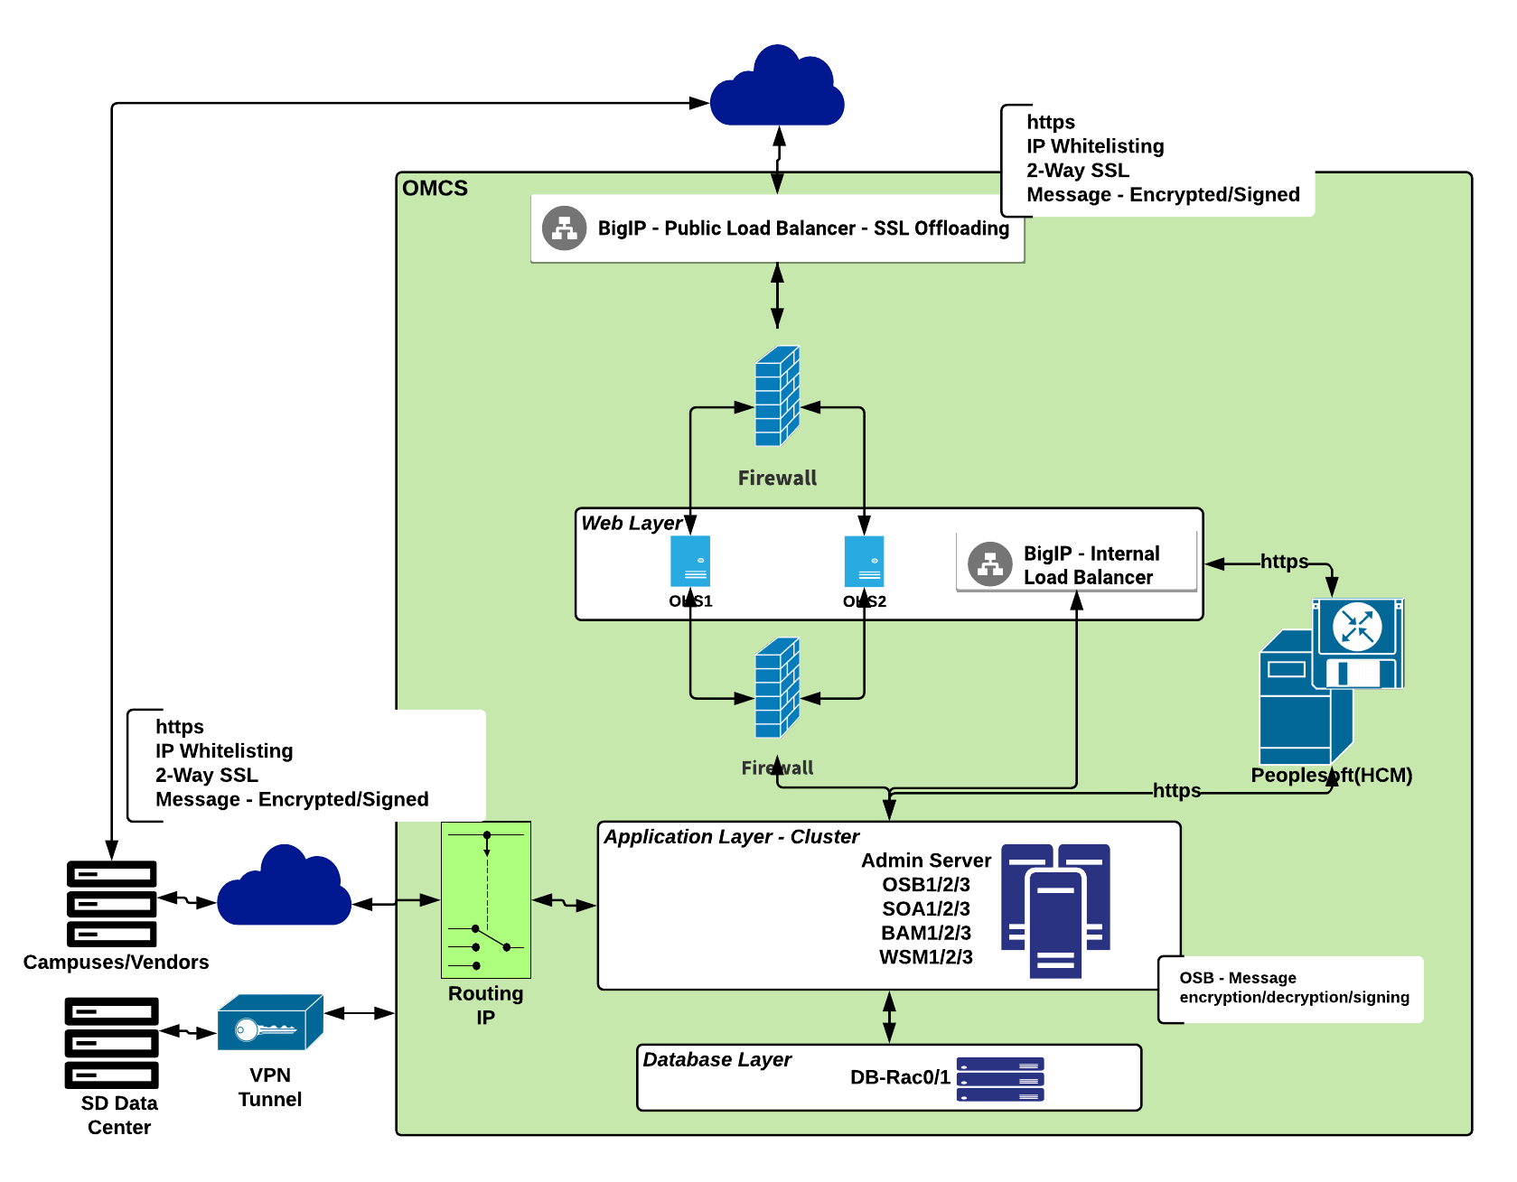
Current Integration Platform…

Slide 8
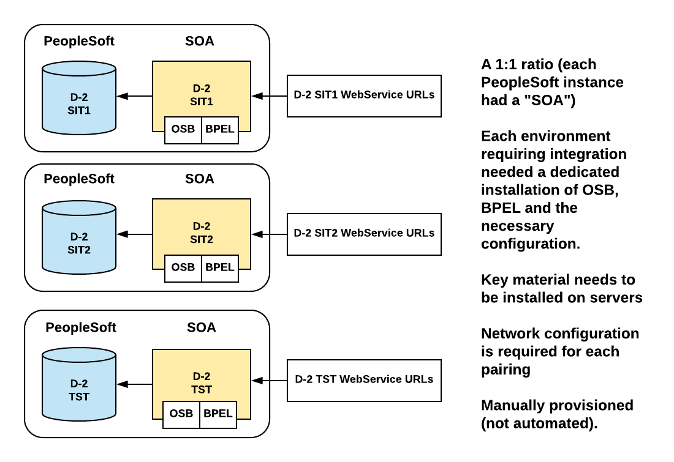
Current Integration Platform…
Many environments + manual configuration

Slide 9
Current Integration Platform…
Where we spend our time
Connecting to locations/vendors – IP/port whitelisting
Network configuration per env
Debugging network configuration issues – Packet capture - Involve OMCS network team
Key management – Per env/manual
SOA stack(OSB, SOA, BAM, OHS, OWSM) per env
Separate consoles for each SOA component
Separate log files
Development IDEs – Jdeveloper(BPEL)/Eclipse(OSB)/Web based console
Compiling and deploying source code – Separate scripts

Slide 10
Opportunity to modernize
Decided to replace the integration platform so we can simplify and automate
Selected IPaaS (Integration Platform as a Service)
IPaaS vendors are investing heavily in their platforms
Most applications are, or will be, cloud-hosted
IPaaS lets us focus on the webServices, not environments, infrastructure
Platform we choose was robust enough to work for system wide projects like UCPath and for multiple campuses use too

Slide 11
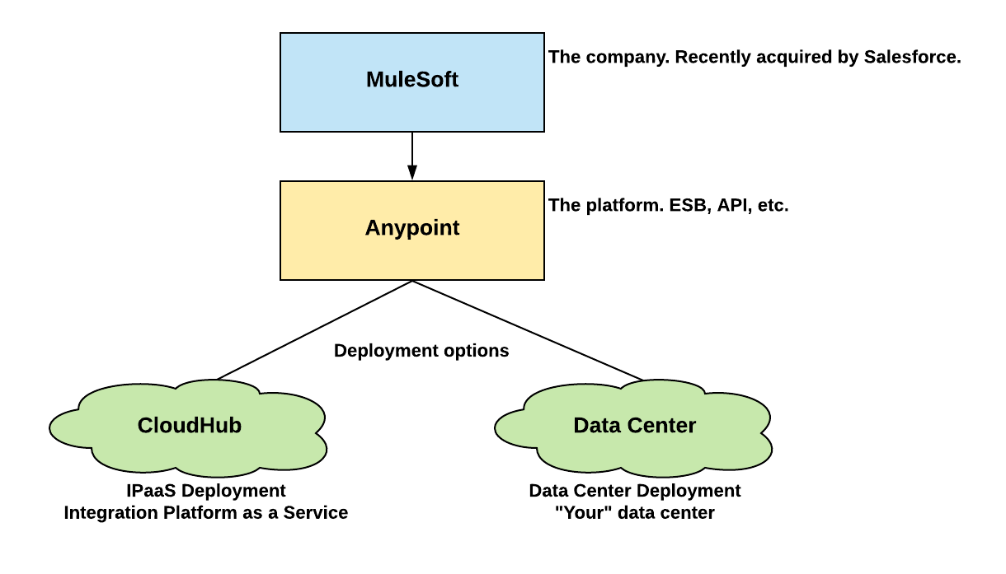
Mulesoft

Slide 12
Anypoint platform
Features of Anypoint platform
Design Center
Exchange
Management Center
Access Management
API Manager
Runtime Manager

Slide 13
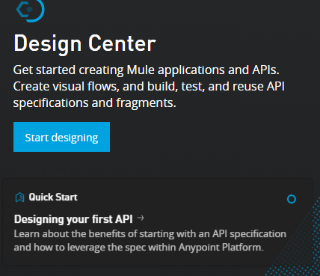
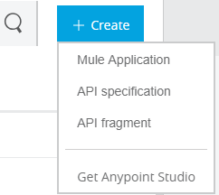
Anypoint platform
Design Center
Mule Application
Hosted environment where we can create Mule apps and test the functionality
API Specification
RAML specification
API fragment
Use/reuse in API spec

Slide 14
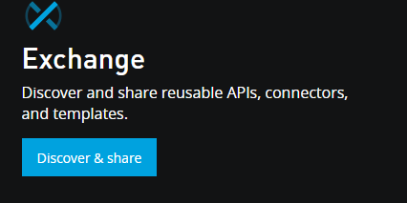
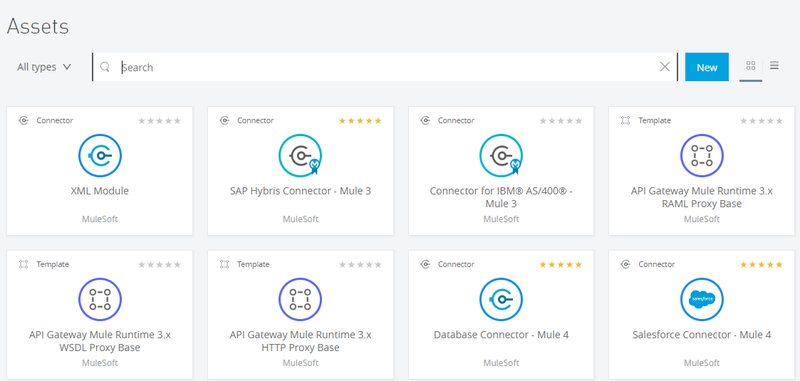
Exchange
Share reusable API’s which can used
across enterprise
Discover API’s shared by other users and request
access to the API.

Slide 15
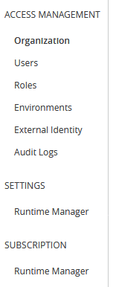
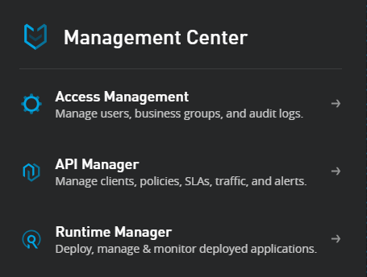
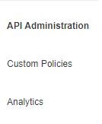
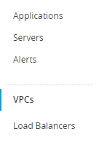
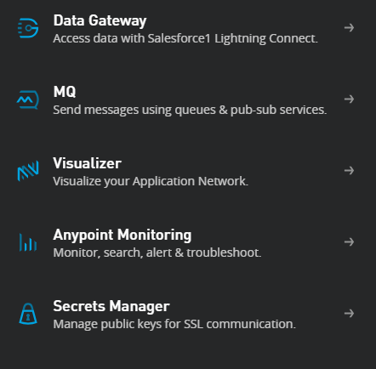
Management Center
API Manager
Runtime Manager

Slide 16
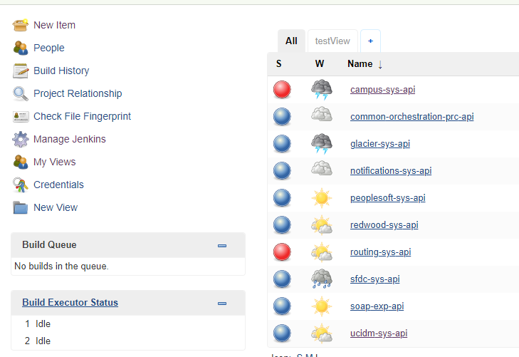
Continuous Integration /Continuous Development
Jenkins is a self-contained, open source automation server which can be used to automate all sorts of tasks related to building, testing, and delivering or deploying software

Slide 17
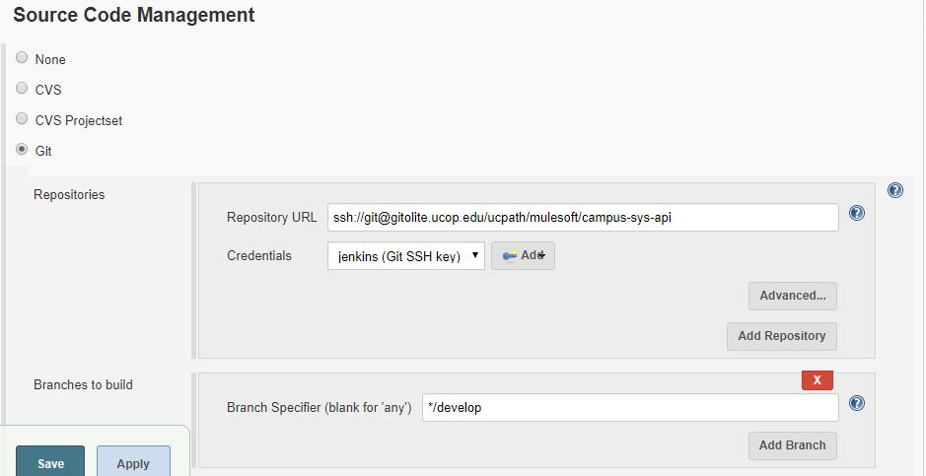
GIT
GIT is the source code repository we are using for mule app’s. Repository URL of GIT and the branch it build’s on

Slide 18
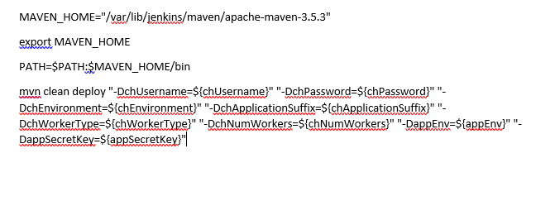
Polling interval
Build script

Slide 19
High-level Architectural Design
Integration Architectural Patterns
API Led Connectivity
Reliability Pattern
High Availability Pattern

Slide 20
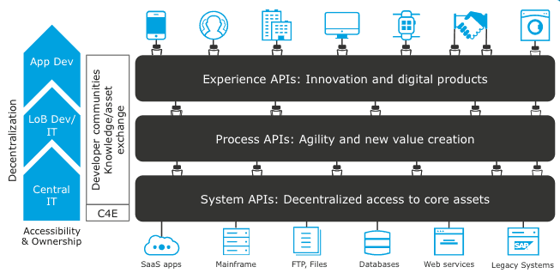
API Led Connectivity
Layers
System APIs
Process APIs
Experience APIs

Slide 21
Reliability Pattern
High-level Architectural Design …

Slide 22
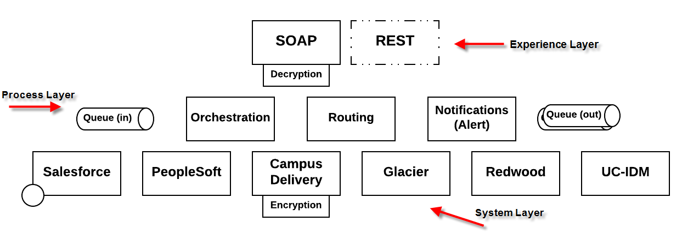
Service Topology
High-level Architectural Design …
Notes:
Accelerate developer productivity with a single graphical environment for integration with SaaS and on-premises systems, data integration, API implementation, and testing. Then deploy your applications on-premises or in the cloud with the Mule runtime.

Slide 23
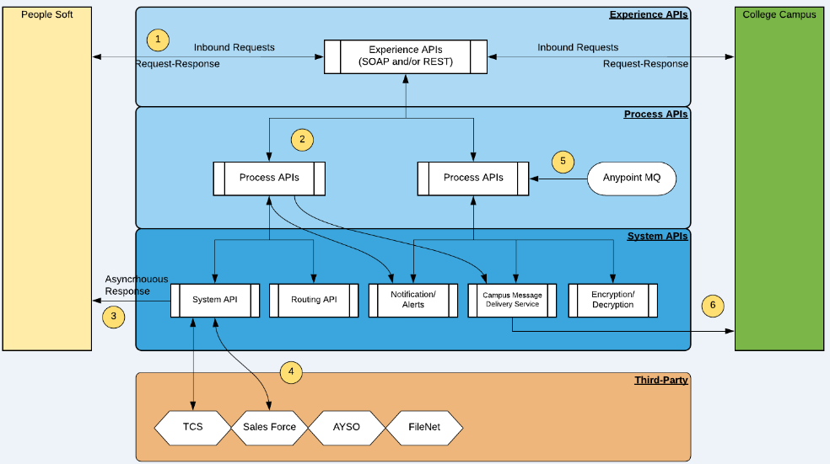
Internal Mule API/Service Architecture
High-level Architectural Design …
Notes:
Accelerate developer productivity with a single graphical environment for integration with SaaS and on-premises systems, data integration, API implementation, and testing. Then deploy your applications on-premises or in the cloud with the Mule runtime.

Slide 24
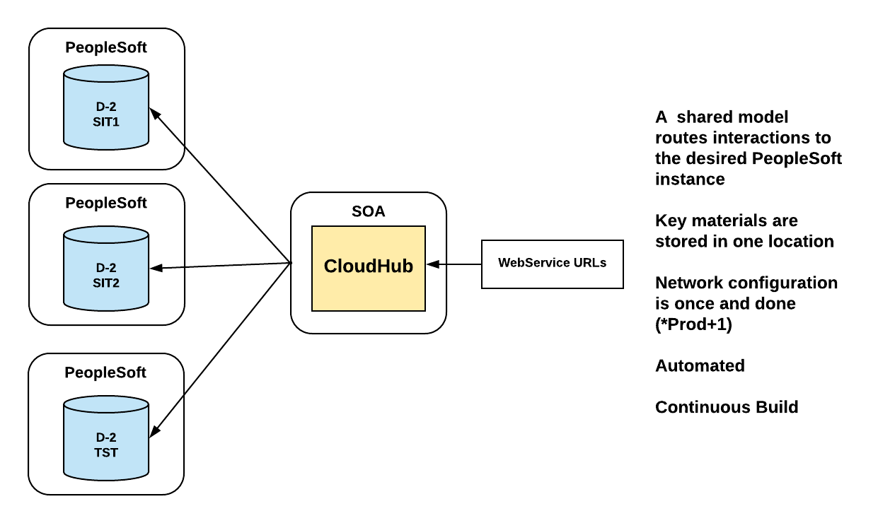
Current Integration Platform…
Few environments, more automation

Slide 25
Anypoint Studio - IDE
Eclipse based IDE, open source & free
Build integrations graphically or in XML
Jumpstart your integrations with pre-built connectors, templates, and examples
Debug with design-time error-handling or Java and XML exception handling
Map and transform data easily - Dataweave
Integrate testing into your existing CI/CD process using MUnit
Easily deploy APIs and integrations built in Studio to the cloud or on-premises
Built-in Maven support
High-level Architectural Design …
Notes:
Accelerate developer productivity with a single graphical environment for integration with SaaS and on-premises systems, data integration, API implementation, and testing. Then deploy your applications on-premises or in the cloud with the Mule runtime.

Slide 26
Mule Application
Flow
Message Source
Message Processors
Connectors
Transformers
Filters
Flow Controls
Scopes
Error Handlers
Sub-flow
Notes:
Accelerate developer productivity with a single graphical environment for integration with SaaS and on-premises systems, data integration, API implementation, and testing. Then deploy your applications on-premises or in the cloud with the Mule runtime.

Slide 27
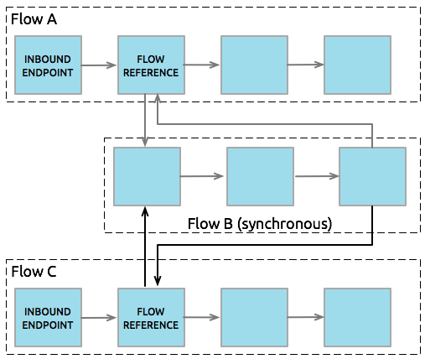
Mule Application …
Notes:
Accelerate developer productivity with a single graphical environment for integration with SaaS and on-premises systems, data integration, API implementation, and testing. Then deploy your applications on-premises or in the cloud with the Mule runtime.

Slide 28
Building a Mule Application
Define API spec in Design Center
Import project into Studio
Generate Flows
Generate Munit
Commit & Deploy
Test
Mule Application …
Notes:
Accelerate developer productivity with a single graphical environment for integration with SaaS and on-premises systems, data integration, API implementation, and testing. Then deploy your applications on-premises or in the cloud with the Mule runtime.

Slide 29
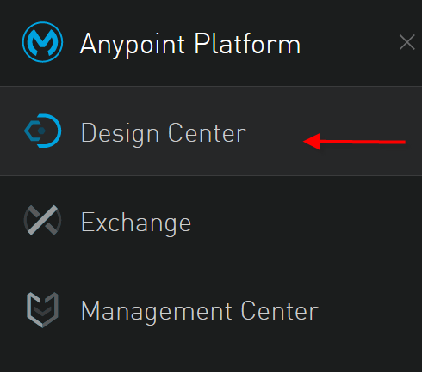
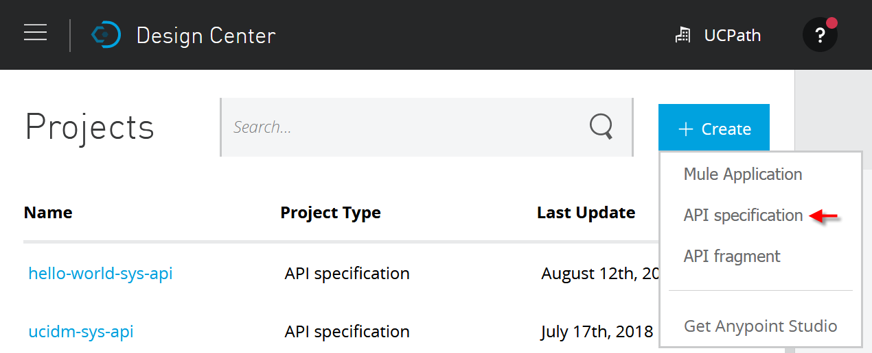
Building a Mule Application
High-level Architectural Design …
Notes:
Accelerate developer productivity with a single graphical environment for integration with SaaS and on-premises systems, data integration, API implementation, and testing. Then deploy your applications on-premises or in the cloud with the Mule runtime.

Slide 30
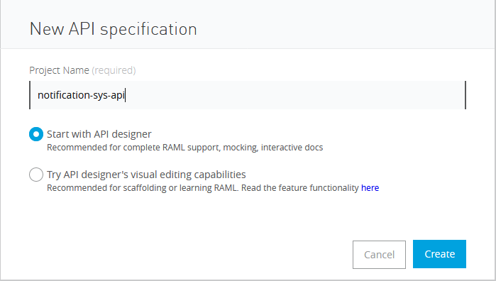
U
C
P
A
T
H
O
N
A
N
Y
P
O
I
N
T
P
L
A
T
F
O
R
M
Mule Application …

Slide 31
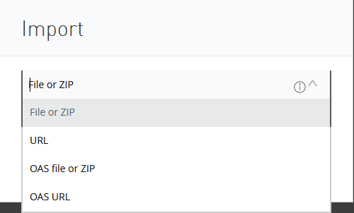
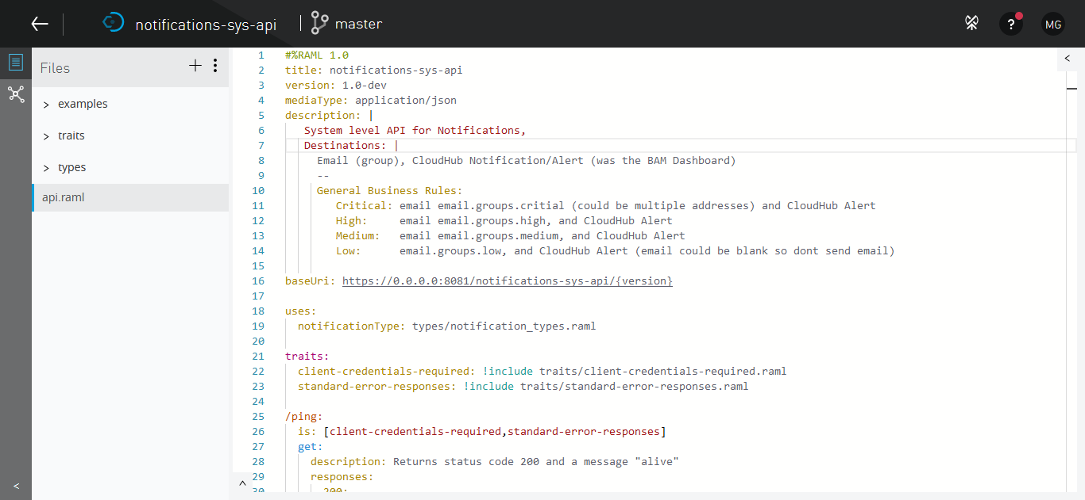
U
C
P
A
T
H
O
N
A
N
Y
P
O
I
N
T
P
L
A
T
F
O
R
M
Create API Specification
Mule Application …

Slide 32
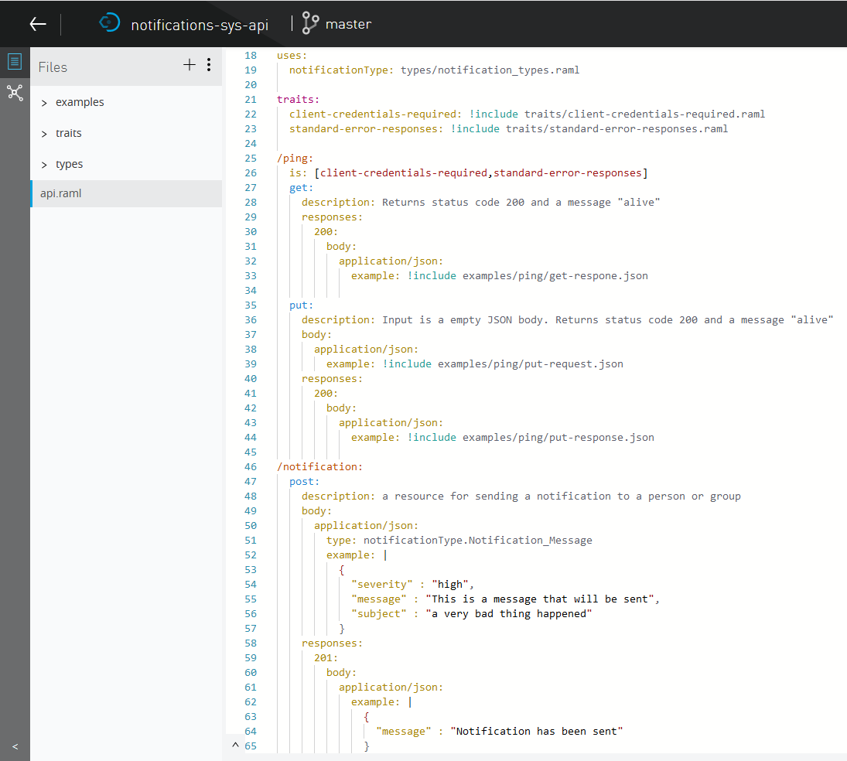
U
C
P
A
T
H
O
N
A
N
Y
P
O
I
N
T
P
L
A
T
F
O
R
M
Mule Application …

Slide 33
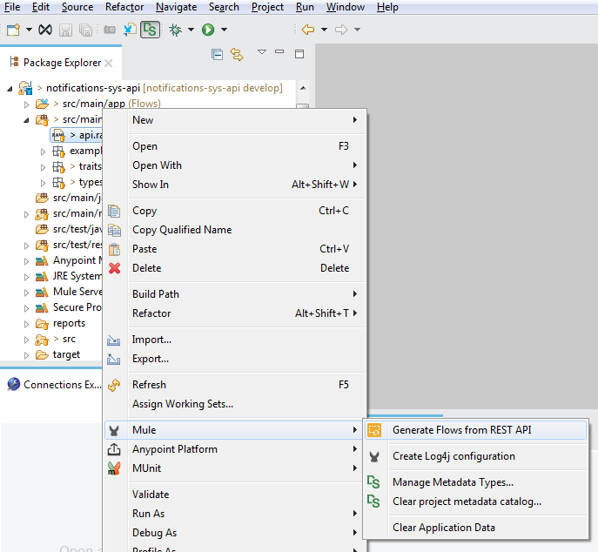
U
C
P
A
T
H
O
N
A
N
Y
P
O
I
N
T
P
L
A
T
F
O
R
M
Import project from Design Center to AnypointStudio and generate flows from the
RAML

Slide 34
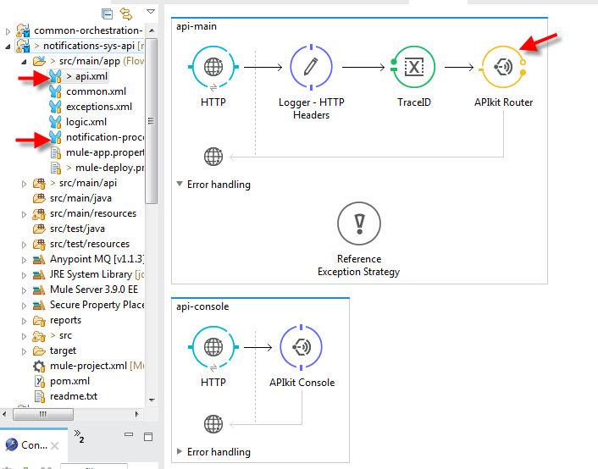
U
C
P
A
T
H
O
N
A
N
Y
P
O
I
N
T
P
L
A
T
F
O
R
M

Slide 35
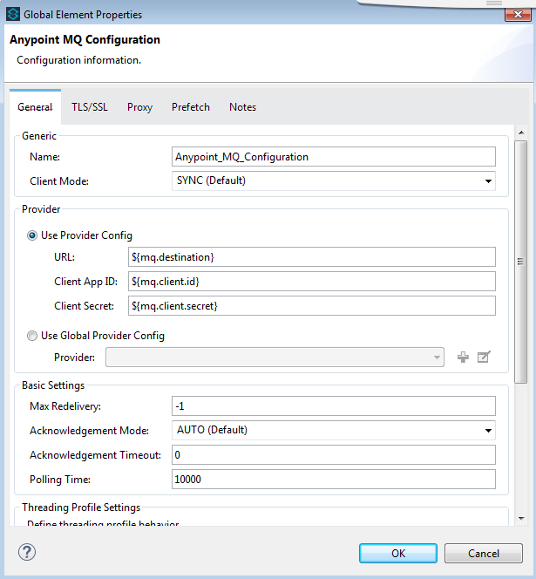
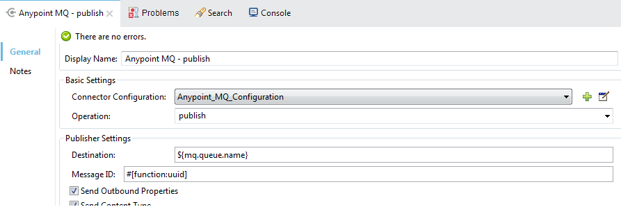
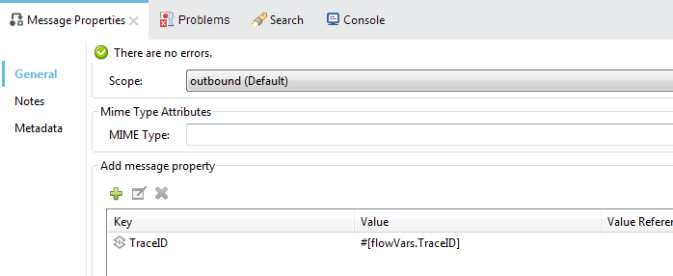
U
C
P
A
T
H
O
N
A
N
Y
P
O
I
N
T
P
L
A
T
F
O
R
M

Slide 36
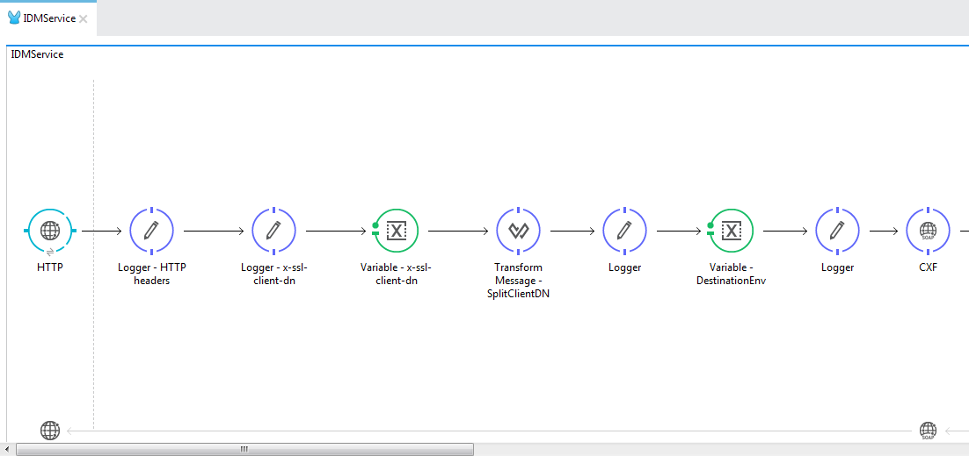
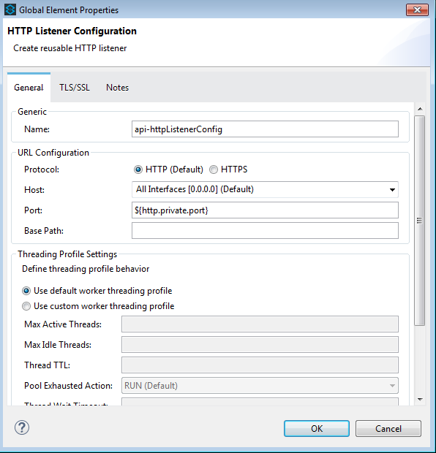
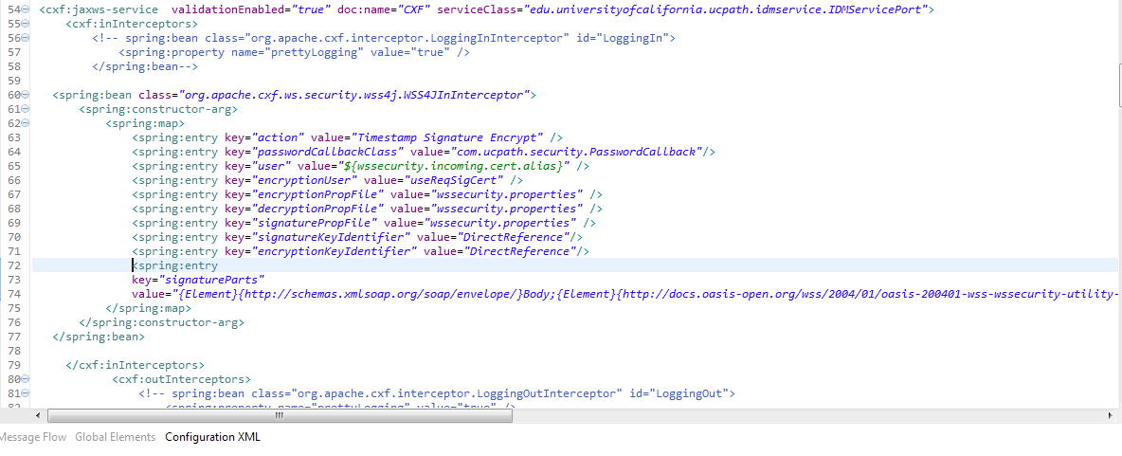
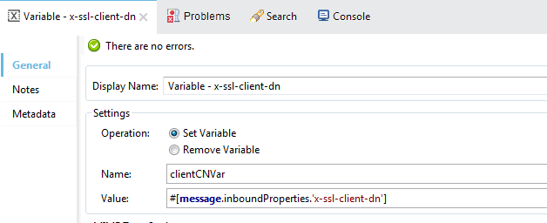
U
C
P
A
T
H
O
N
A
N
Y
P
O
I
N
T
P
L
A
T
F
O
R
M

Slide 37
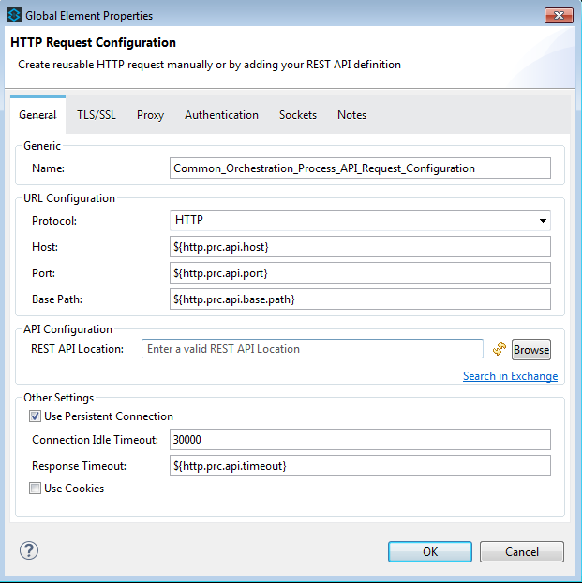
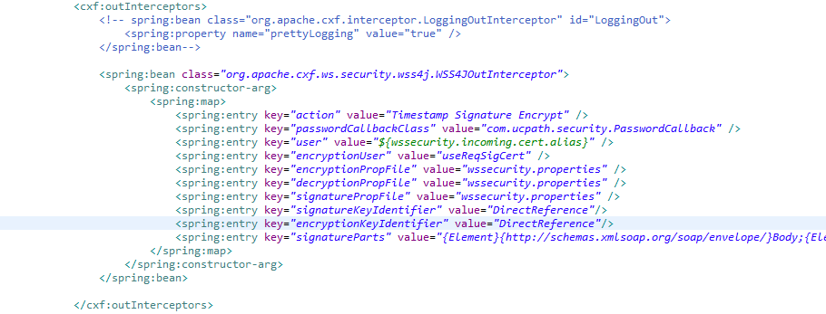

Slide 38
UCPath APIs
U
C
P
A
T
H
O
N
A
N
Y
P
O
I
N
T
P
L
A
T
F
O
R
M
System Layer (8)
ucpath-campus-sys-api
ucpath-glacier-sys-api
ucpath-peoplesoft-sys-api
ucpath-redwood-sys-api
ucpath-routing-sys-api
ucpath-sfdc-sys-api
ucpath-ucidm-sys-api
ucpath-notification-sys-api
Process Layer (1)
ucpath-common-orchestration-prc-api
Experience Layer (1)
ucpath-soap-exp-ap

Slide 39
Anypoint Platform – Experience So far
U
C
P
A
T
H
O
N
A
N
Y
P
O
I
N
T
P
L
A
T
F
O
R
M
Faster development – Migrated 17 SOA services to 10 APIs in 3 months
One IDE - design, develop, unit test, deploy
Less custom code – Out of the box connectors, components
Transformations made easy - Dataweave
2-way SSL, Msg Encr –CXF vs WSC
One log file
Very responsive customer support

Slide 40
Organization and Business Groups
U
C
P
A
T
H
O
N
A
N
Y
P
O
I
N
T
P
L
A
T
F
O
R
M
Organization
Our top level org is “UC Online”.
This is the parent Entity and holds all the parent assets
The administration of Business Groups is delegated to the Business group admins under the parent org
Business Groups
Business Groups are sub-entities created under the “UC Online” organization above
This can be a system wide project e.g. UCPath, or a Campus e.g. UCMerced, UCOP
Business group owner is the Business group admin
There are multiple Business groups within the “UC Online” organization above

Slide 41
Asset Sharing – API Exchange
U
C
P
A
T
H
O
N
A
N
Y
P
O
I
N
T
P
L
A
T
F
O
R
M
Exchange Private
For internal developers (viewer, contributor, or administrator access)
Assets could be limited to Business groups
Exchange Portal
Exchange admins only can share assets
Shared Externally with developers outside of their own organization
What can be shared ?
Mule XML example code, Template, Connector, APIs
Custom information assets.
Advantages
Model and reuse code and APIs
Easy access
Create a repository

Slide 42
Organization and Business Groups
U
C
P
A
T
H
O
N
A
N
Y
P
O
I
N
T
P
L
A
T
F
O
R
M

Slide 43
UCOP - UCPath IDM Interfaces
U
C
P
A
T
H
O
N
A
N
Y
P
O
I
N
T
P
L
A
T
F
O
R
M
UCOP is Providing and Consuming Services to/from UCPath since past few years.
Current UCOP setup for services
The current interfaces are deployed on JBoss Application server.
Where we spend our time
Maintaining the Application server.
Regenerating the class for any WSDL changes.
This also involves deployment of new artifacts.
Software upgrades for Application server.
Maintaining Multiple environments(Dev, QA, UAT, Prod).
Coordination with Multiple team.

Slide 44
U
C
P
A
T
H
O
N
A
N
Y
P
O
I
N
T
P
L
A
T
F
O
R
M
Looking at the features MuleSoft is providing UCOP IAM has selected MuleSoft as the new integration platform.
Mule is the most lightweight integration platform available.
Mule integrates tightly with Spring.
Mule uses common tools that all Java developers are familiar with, like Maven, Eclipse, JUnit and Spring.
Mule IDE Anypoint Studio helps new developers get up to speed quickly with a graphical development environment.
Process large messages efficiently XML, JSON, flat files, binary and file attachments, streams, and Java objects.
Provides flexibility to deploy apps on cloud or on premise.
Upgrades managed by MuleSoft

Slide 45
UCOP IDM interface to CloudHub
U
C
P
A
T
H
O
N
A
N
Y
P
O
I
N
T
P
L
A
T
F
O
R
M
Maintaining and syncing the repository (i.e. WSDL, XSD and other changes) – Use of API Exchnage
To keep up with the market and technology evolution.
In Line with UCPath and other UC who are using MuleSoft.
Deploy same code base across multiple environments.
Reduces the dependency of Application servers plugins.

Slide 46
Anypoint Platform Support for SSO
U
C
P
A
T
H
O
N
A
N
Y
P
O
I
N
T
P
L
A
T
F
O
R
M
In Anypoint Platform, has a future to configure External Identity.
Anypoint Supports SAML2.0.
Anypoint Platform was tested configuring using Shibboleth.
Login to Anypoint and click on external identity to configure the IDP.

Slide 47
My Experience with MuleSoft
U
C
P
A
T
H
O
N
A
N
Y
P
O
I
N
T
P
L
A
T
F
O
R
M
When did I start thinking about MuleSoft.
How did I approach.
Training on MuleSoft.
Process/Plan to Migrate existing UCOP IDM interfaces.
Testing UCPath interfaces

Slide 48
Training
Easy to learn
Basic knowledge of XML, JSON, java/object oriented programming and integration technologies such as HTTP, JMS, JDBC, REST and SOAP.
Mulesoft provides free self study development fundamental course
Trainings we took:
Anypoint Platform Development: Fundamentals (Mule 3) - Online instructor-led
API Dev Advanced Training – 3-4 days – Online instructor led
Please check https://www.training.mulesoft.com for more information

Slide 49
CoE (Center of Excellence)
UCOP is going to form a new COE to provide consultation and professional services on the CloudHub platform.
Members:
Jerome McEvoy (jerome.mcevoy@ucop.edu)
Mukund Gidadhubli (mukund.gidadhubli@ucop.edu)
Rahul Morthala (rahul.morthala@ucop.edu)
Sushant Prasad (sushant.prasad@ucop.edu)
Krishna Mohan (krishna.mohan@ucop.edu)
Contact any member if your have questions

Slide 50
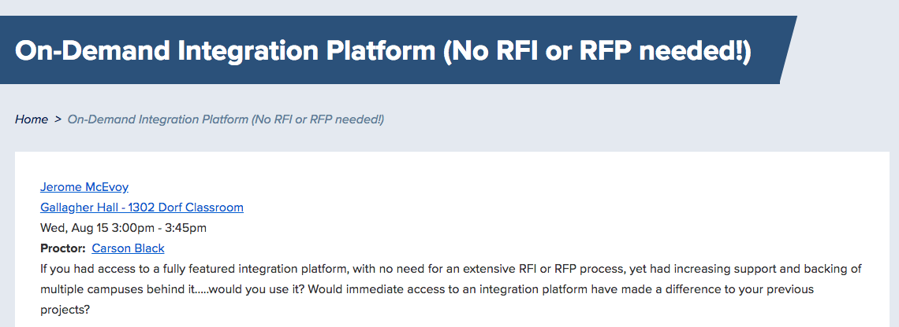
Learn more about accessing CloudHub (in 30 minutes)

Slide 51
Q & A

