Slide 1
Can Airtable improve your department’s operational efficiency?
Steve Miley / UCSB Bren School of Environmental Science & Management
smiley@ucsb.edu

Slide 2
My Bio
25+ years at UCSB and 3 different stints in private industry
IT Systems Admin / Project Manager / Network Analyst / IT Director / Software Architect / Release Engineer
Current – IT Director at the Bren School of Environmental Science & Management
Key point – I’ve built lots of software, but see Airtable as a better way for some applications

Slide 3
Agenda
The problem that brought me to Airtable: Duplicated data (People, Computers, Offices)
Basics on licensing of Airtable
Demo covering key features our our primary use case
Integration with MyPlan – curriculum planner – exports / reports
Top features missing / Community forum
Observations on our use / Next steps
Questions

Slide 4
By the end of the presentation, I’m hoping you will …
See how flexible Airtable is
Understand some of our use cases and how we benefited by it
Have curiosity to explore Airtable before writing a custom application
Understand the costs / key functionality / common frustrations
Understand quote - Airtable – “organize anything” ease of spreadsheets power of databases
Know you can import data from file, copy paste, feed from api and enter manually, or add view form

Slide 5
Why did we look at Airtable?
We’d store this info in spreadsheets, powerpoint, pdq inventory, spiceworks, zendesk, Sassafras. Same information, multiple places, bad.
We get lots of in person and email help tickets, we often wonder
  Who is this person
  Who is their sponsor
  What office are they in
  What computer are they using
We have a constant flow of visiting researchers, what office should they go in
Didn’t want to develop a custom web/db app for person/computer/office

Slide 6
Airtable licensing/pricing
Free – 1,200 records ber base 2 week backups/revision
Plus($10 user/month) – 5,000 records per base, 6 months backups/revision
Pro($20 user/month) – 20,000 records per base, 1 year backups revision + lots of features – private links / locked views / personal views / …
Edu discount – 50% off ;
price per user/editor, readonly users free with pro
https://airtable.com/pricing

Slide 7
Airtable Basics
Base – collection of spreadsheets
Users Roles
  Owner
  Creator
  Editor
  Commentor
  Read Only
Snapshots / Copies / Record level audits
Snapshot / record audit retention
Collaborative editing of same sheet / record!

Slide 8
Airtable core features
Views – fields (hide/show) / arrangement / grouping / filters / sorting / size of columns ; shared and personal
Field Types - 21 ; link to another sheet ; lookups, single/multiple select, formulas, attachments, …
Blocks – pivot tables ; graphs ; …
Import data ; load via api, manual input grid; external webform

Slide 9
Screen Shots of Key features ; then demo

Slide 10
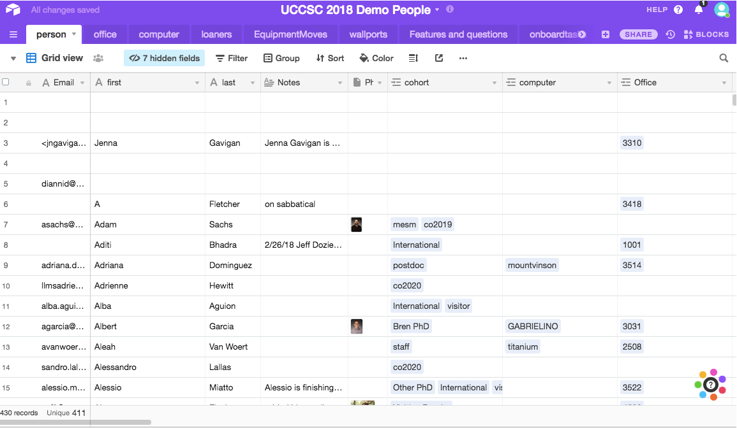

Slide 11
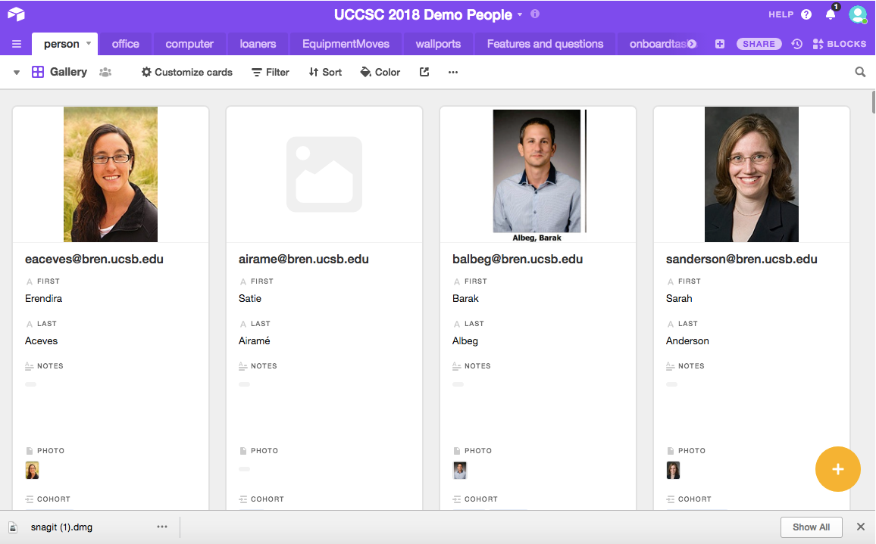

Slide 12
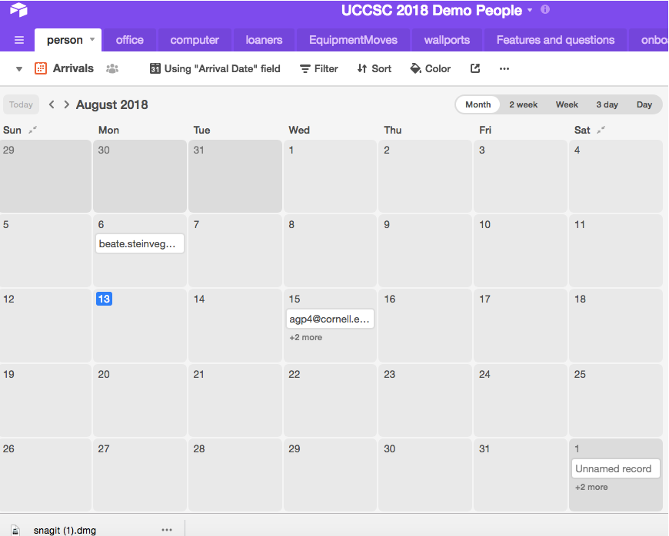

Slide 13
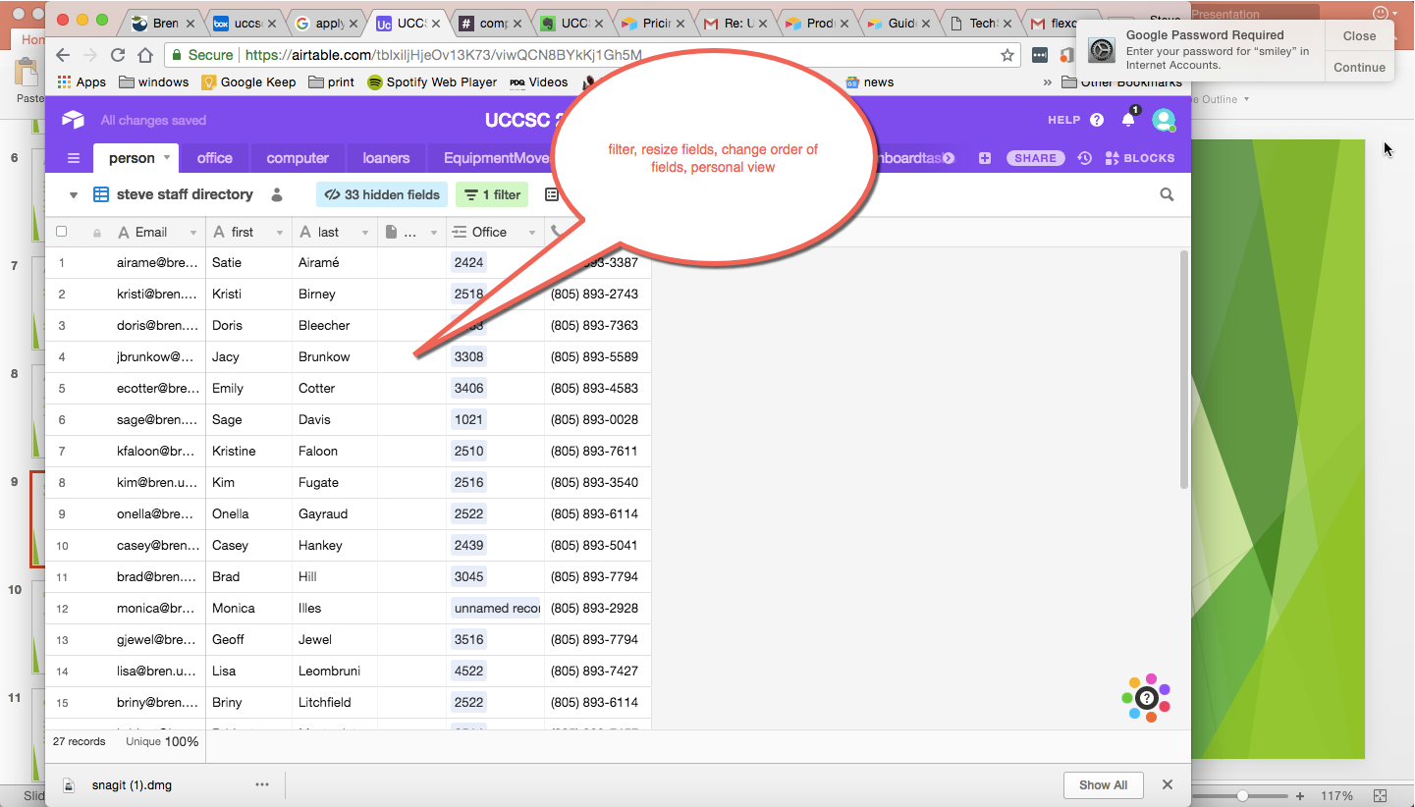

Slide 14
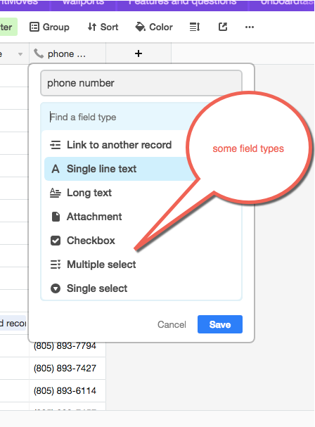

Slide 15
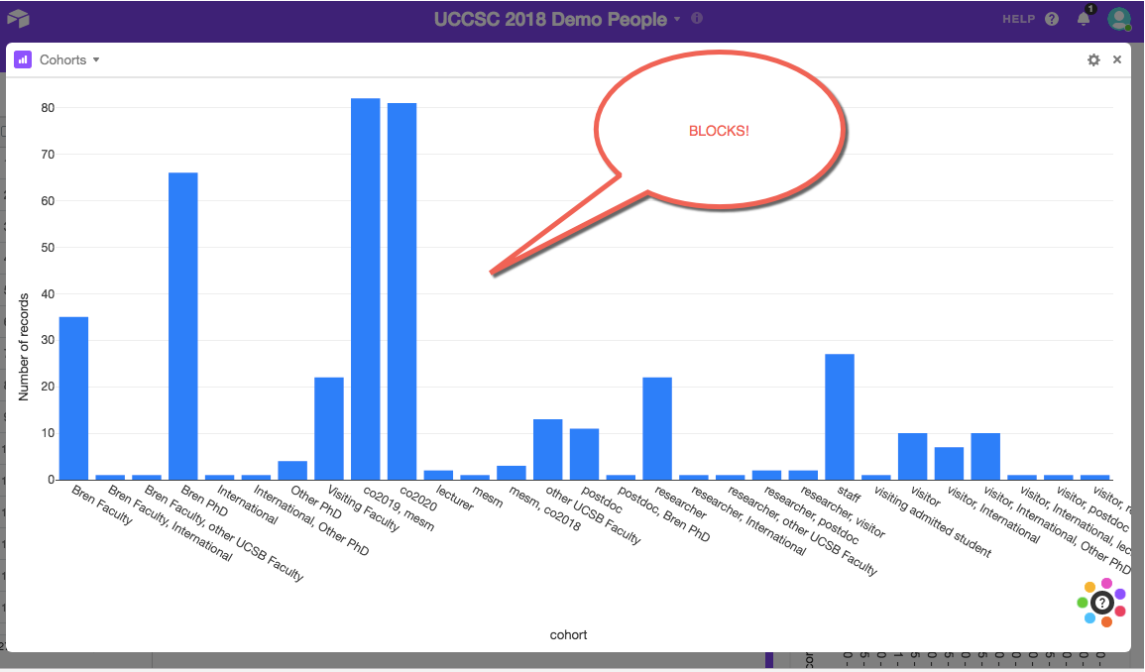

Slide 16
Live Demo or video

Slide 17
Demo -
Demo of primary “base”
  Sheets
  Views
  Fields types
  Record modification audits
  Blocks
  Import / export
  API Porgramming

Slide 18
Feature Creep
We added projectors with a link to view in our knowledgebase
We added our required mapping of rooms to room types
We created a capacity of an office and an availability report
We grouped visitors / PhD / Researcher / Postdoc by sponsor
We created a separate Base for Servers/Switches ; Tasks ; Emergency List

Slide 19
API integration / MyPlan
MyPlan – curriculum planner we built – reports ? Prototypes
Copy/Paste 3 tables
API to delete / load data automatically
Reports / Views
Problem – always want LIVE data ☹
Quick Demo -

Slide 20
Top Features Missing
https://community.airtable.com/c/feature-requests?order=views
Using a spreadsheet for multiple bases – no data replication
Having different access for different people for different tables in a base – advanced user permissions
Column that is unique ** no duplicates
Screen shot – Next Page

Slide 21
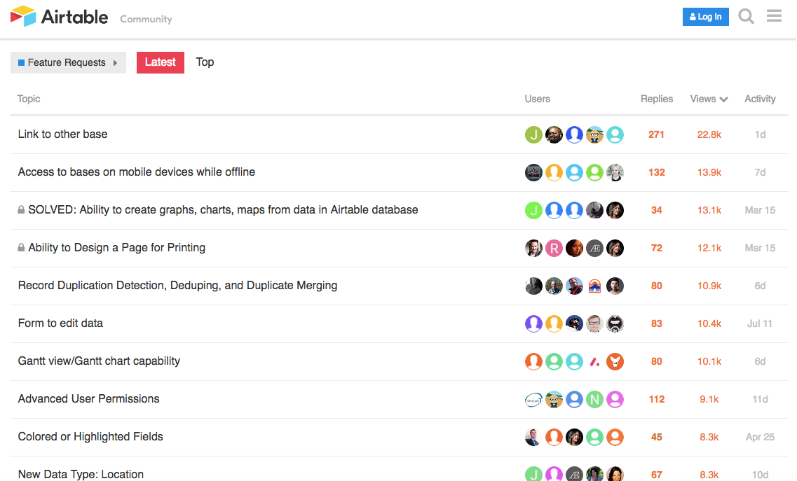

Slide 22
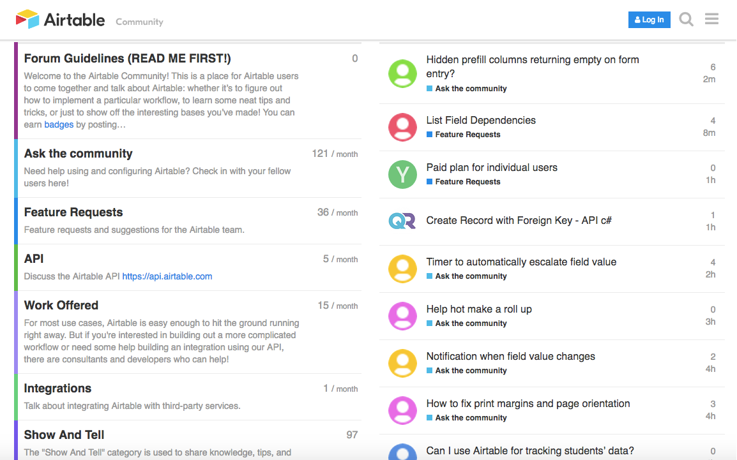
Community Forums

Slide 23
Observations
Training and retraining was required
New Process for onboarding, required getting buy in, and feedback to tune process
I seemed to have more interest in googling new people to get more information on them to add to our profile (photo, what they did)
Errors in data management – rather than remove office assigned to person and add new office, office # was changed ** NEED FOR protected fields
Slow to adapt and use new systems ; desire to keep with old methods
Hard to understand concept of views / shared / personal and modification of views changes for all

Slide 24
Observations –Continued - outreach
Environmental Studies – thesis database on the web
  5 minutes – prototype – 1 day data cleaned, views exposed
  Don’t need to pay
Geography – interesting, spreadsheets, cost $$ , sorry
LSIT – we’re using JIRA

Slide 25
In Summary
Check out the free version
If you are a power user with Excel (pivots tables, lookups, …) you’ll get it and see how useful it is
I think it really needs an advocate and one who can design a properly architected “BASE”
I can see how a central group could design a BASE, that gets used by multiple departments for a common business workflow. Where this is an application that gets revised and updated over time
Its going to be like Dropbox in a few years (everyone using it), but I also have thought the market has going to crash over the last 5 years.

Slide 26
Questions
Thank you for your time
Questions?

