Slide 1

Aggie Desktop
UCCSC 2018
2018-08-14
aggiedesktop@ucdavis.edu
aggiedesktop.ucdavis.edu

Slide 2
The Idea
We each run . . .
  WSUS
  BigFix
  MDT/WDS
  Antivirus, . . .
This means we . . .
  Maintain OS images
  Deploy systems
  Push patches
  Push software, . . .
Why duplicate all this work?
Let’s work together!
Let’s do it the Right Way™!
That’s Aggie Desktop.

Slide 3
Partnership
College of Engineering
College of Letters & Science
Finance, Operations & Administration
Information and Educational Technology
Academic
~25% of campus
endpoints
Administrative
Once we get it working for the initial partners, we offer it out to campus.

Slide 4
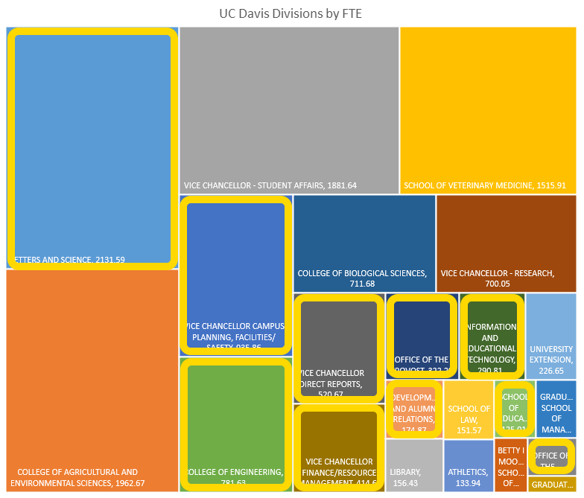
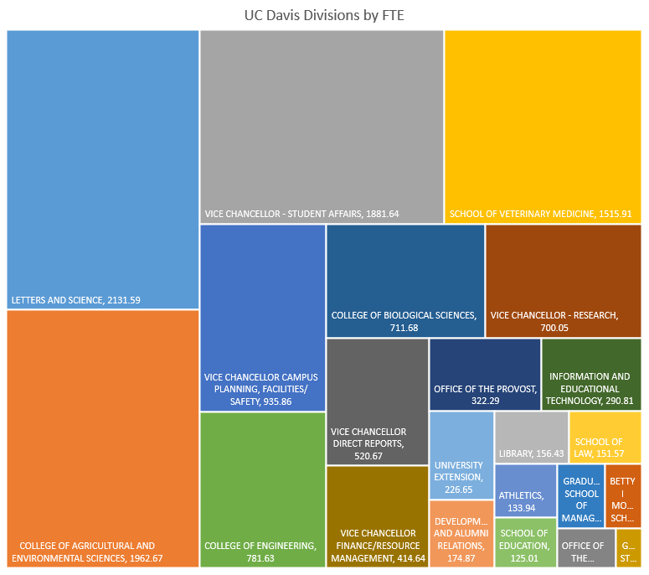
Partnership

Slide 5

Principles
Buffet-Style Services
  Take what you want, leave what you don’t.
Three Laws Safe
  Make it easy for the end user.
  Make it easy for local IT, when that doesn’t interfere with 1.
  Make it easy for Aggie Desktop, when that doesn’t interfere with 1 or 2.
We Eat Our Own Dogfood Drink Our Own Champagne

Slide 6
Staffing
Development Team
  Using Agile/SCRUM Methodology
  ~10 core members
    ~0.25FTE each
    Systems Administrators, Developers, Business/Technical Support Analysts
Operations Team
  ~6 members
    0.10FTE each
    Systems Administrators, Business/Technical Support Analysts
Governance Committee
  4 members, one from each partner

Slide 7
Service Model
Aggie Desktop will . . .
  Maintain deployment, management, and self-service infrastructure.
  Maintain and test OS deployment images/automation.
  Test and deploy patches for OS and applications.
  Provide self-service for application installation and configuration.
  Serve as an escalation point for IT partners.
Aggie Desktop will not . . .
  Provide end-user support.
  Handle software licensing (some services have licensing requirements).
  Handle hardware procurement (but will work with Financial Sustainability).

Slide 8
Service Model

Slide 9
Successes and Challenges
Successes
  Awesome team
  More than 2,000 systems deployed.
  ~5,000 systems being patched.
Challenges
  Low FTE commitment slows progress (we all have day jobs)
  Broad diversity of needs and environments are hard to accommodate
  The best toys are expensive

Slide 10
Aggie Desktop
Questions?
aggiedesktop@ucdavis.edu
aggiedesktop.ucdavis.edu
itcatalog.ucdavis.edu/service/aggie-desktop
kb.ucdavis.edu

