Slide 1
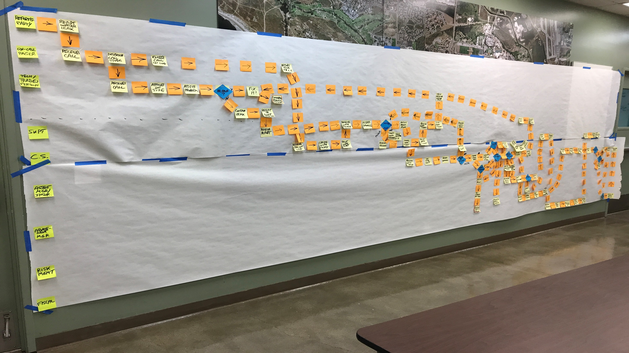
Kaizen
“Good Change!”
Gary Fix
Associate Director IT DFSS
University of California, Santa Barbara
gary.fix@ucsb.edu
2018-Aug-15

Slide 2
Kaizen
Imagine that you have been asked to identify improvements to one of the worst Business Process Work Flows “ever”!
Where do you start?

Slide 3
Kaizen
Now suppose you could reduce the number of steps for the worst Business Process by 67%!
In one week or less!
Interested?

Slide 4
Kaizen
What It Is
Why It’s Important
How It Works
How We Did It

Slide 5
Kaizen - What Is It
A Philosophy of Continuous Improvement
Focus on Eliminating Waste
“Change for the Better …by Everybody! Everyday! Everywhere!” [1]
“…a Strategy where Employees at all Levels… Work Together Proactively to Achieve Regular, Incremental Improvements to [a] Process.” [2]

Slide 6
Kaizen - What Is It
“Kaizen is Part Action Plan and Part Philosophy.”
The Action:
“Organize Events Focused on Improving Specific Areas within an Organization”
The Philosophy:
“Develop a Culture Where All Employees are Actively Engaged in Improving the Organization”
“Consistent Application of Kaizen as an Action Plan Develops Kaizen as a Philosophy.”
[2]

Slide 7
Kaizen - Why It’s Important
Table 1: Results of Kaizen Event [4]
Metrics | Original | Goal | Actual: 1 Week Later | Improvement
Lead Time | 8.5 days | 5.0 days | 2.7 days | 68%
Total Cycle Time | 5.7 min. | 5.7 min. | 2.9 min. | 49%
Invoices | 2056 | 1985 | 938 | 54%
Walking Distance | Total/Day: 8381′ | No Goal | Total/Day: 2232′ | 73%
Productivity (output/- person/effective hours) | 12.8 | 15.5 | 15.5 | 21%
[3]

Slide 8
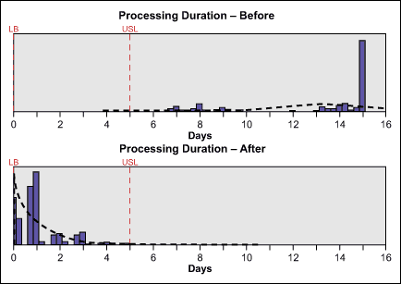
Kaizen - Why It’s Important
Invoice Processing Duration [4]
[3]

Slide 9
Kaizen - How It Works…
Scoping Meeting
Day 1:
Requires a Multi-Day, Full-Time Commitment
Review the Kaizen Event Process
Goals and Objectives from the Scoping Meeting
Define the Scenario
Goal for Today: Map the Current Process
Day 2:
Review of Day 1
Group Exercises – Observations, Themes and Brainstorming
Begin Mapping the New “Ideal” Process

Slide 10
Kaizen - How It Works
Day 3:
Review of Day 2
Complete Mapping the New Process
Compare New Process to the “Objectives” from Day 1
Create an “Action Plan”
Identify Improvement Metrics
Closing Summary
Follow Up:
At Least Monthly Reviews

Slide 11
Kaizen - Scoping Meeting…
About 4 to 6 Weeks Before the Kaizen Event
Facilitator Summarizes the Event
Business Process “Owner” / Decision-Making Authority
May Include Another Key Stakeholder and IT
Logistics
Define 2 to 3 Goals / Objectives with Measurable Outcomes
Define Clear Start and End of the “Process”
Identify the Stakeholders (12 to 15 Max)
Want “Influencers”, “Optimists”, Those With Something to Say, Active Participants, Good Cross Section
Ground Rules

Slide 12
Kaizen - Scoping Meeting…
Business Process “Owner” / Decision-Making Authority
Unblocks Stalled Decisions / Directions
Ensures Regular Follow Up Meetings and Action Items
Subject Matter Experts (SME)
IT
Wild Card
Not Involved with the “Process”
Provide an “Outsiders’” Perspective
Note-Taker
Non-Departmental (Optional)
Non-Organizational (Optional)
Logistics Coordinator

Slide 13
Kaizen - Ground Rules…
In Room Commitment
No Cellphones / Tablets / Laptops / Computers
All Voices are Equal and Important
“No Shame, No Blame”
Honor with Respect the Work of Those that Built the Current System
Spirit of Collaboration and Team Work
Be Engaged
Work for Consensus

Slide 14
Kaizen – Day 1…
Kaizen is a “Mental Exercise”
Focus on Eliminating Waste
Toyota – 1960s – Painted Foot Prints on the Factory Floor
Make the Business Process “Visible”
“Can’t Fix What You Don’t Understand!”
Review Scoping Event Goals / Objectives
A Kaizen Implementation Can Take a Good 12 to 18 Months

Slide 15
Kaizen – Day 1…
The “7 Categories of Waste”
Backlogs
Missing, Incomplete or Redundant Information
Waiting
Over-Processing
Decision Points
Excessive Motion
Defective Process

Slide 16
Kaizen – Day 1…
The “Kaizen Coffee Video”

Slide 17
Kaizen – Day 1…
The Kaizen Event “Scenario”
A Work Request has been Submitted Stating that a Building (“Recharge”) has a Locker Room with Flooding Water.
Scenario “Start”
Scenario “End”
Map the Current (“As-Is”) Process

Slide 18
Kaizen – Day 1…
Mapping the Current (“As-Is”) Process
People May Have Different Ideas of the Current Process so Work on a “Consensus Basis”
Post-Its:
Swim Lanes for User Roles
Tasks / Process Steps
Arrows / Process Flow
Decision Point / Diamond
The “System”
Black Outline / Frame = “Out of Scope Process / System”

Slide 20
Kaizen – Day 1
The “Parking Lot” - Issues / Questions Outside “Scope” or Cannot be Answered at This Time.
Example Parking Lot Issues:
Data errors not always corrected at Source. When errors are fixed at end, the documentation is not an accurate history.
No clear way to reconcile total number of parts used on a job if parts were stocked on a truck.
No Audit Function, or it is not enabled. No Audit Trail. Have to do PDFs.
Everything on hold if Supt is out (vac or ill) until back in office. Clarify the process.

Slide 21
Kaizen – Day 2…
“What are Your Thoughts Today?”
Look at the Current “As-Is” Process
Count Steps, Loops and Decisions
Save for Later
Now doing “Strategic Planning”.
When we Start the “Action Plan”, will be in “Tactical Planning”.

Slide 22
Kaizen – Day 2…
Observations
Divide into Groups of about 5,
Take 20 Minutes, and
Identify 5 to 6 Observations of the Current “As-Is” Process
Identify Issues and Problems
Don’t Jump to Solutions Yet!
Spokesperson for Each Group Share the Group’s Observations

Slide 23
Kaizen – Day 2…
Example Observations:
“Missing / Incomplete Information”
“Waiting On Someone to Move Forward”
“Dead Data”
“Too Complicated / Too Much Room for Error”
“Redundant Systems for Data Entry”
“No or Little Feedback to Customer”
“Paper Work Ticket: Hand Written Notes are Lost, Expenses are Lost”

Slide 24
Kaizen – Day 2…
Themes
Distill the Observations into 5 to 7 Main Themes
Think of a “Theme” as a 30,000 Foot “Observation”
Example Themes:
“Redundant Tracking Systems (for Parts & Labor)”
“A Lot of Decisions / Guessing”
“Too Much Paper”
“Inconsistent / Non-Standard Practices”

Slide 25
Kaizen – Day 2…
Brainstorming Solutions
Back in the Groups,
30 to 40 Minutes,
For Each “Theme”, Write Down Two “Actionable Tasks”
“How Can We …?”
Opportunity to Revolutionize the Process!
What is it You Would Really Like to See Happen?
Be Creative as Humanly Possible but Realize we Don’t Have a Magic Wand

Slide 26
Kaizen – Day 2…
Brainstorming Solutions
When Time is Up, Each Group gets 10 Minutes to Elaborate on the Ideas
Example Solutions:
“Improved User Interface with Less Free Form”
“Pre-Approved Account Numbers”
“Barcode Parts”
“Document Standardized Processes for Others”
“Validate Data at the Source of Entry”

Slide 27
Kaizen – Day 2…
Begin Mapping the “Ideal” Process
“Can We Do Better?”
Important!!! If Add a New Step/Task on the New Process that is Not on the Current (Old) Process, Question It!
Ask “Why?”
Else Must Go Back and Add the New Step/Task to the Current (Old) Process.

Slide 28
Kaizen – Day 3…
Complete Mapping the “Ideal” Process
When “Done”, Review the “Objectives” and Ask If We Met / Achieved?
Summarize Benefits
From the “New Process”
Metrics
Compare “Current” to “New” Process

Slide 29
Kaizen – Day 3…
Current Process |  | New Process
People Steps |  | People Steps
Steps Best Case | 49 (2 – 4 Weeks)
Steps Worst Case | 195 (3+ Months)
Loops | 14
Decisions | 20

Slide 30
Kaizen – Day 3…
Current Process |  | New Process
People Steps |  | People Steps | “System” Steps
Steps Best Case | 49 (2 – 4 Weeks) | 18 (63% Decrease) | 5
Steps Worst Case | 195 (3+ Months) | 65 (67% Decrease) | 15
Loops | 14 | 2 (86% Decrease)
Decisions | 20 | 15 (25% Decrease)

Slide 31
Kaizen – Day 3…
Create an “Action Plan”
Chart “Impact” Against “Difficulty”
Impact Levels: 0 = No Impact, 10 = Critical (Must Do This, Necessary for Success)
Difficulty Levels: 0 = Super Simple, 10 = Super Hard
Consider “Parking Lot” Items but Not “Themes”
Create a List of “New Process Dependencies”
Enter the Action Plan Tasks (“TODOs”) into a Spreadsheet or Project Plan

Slide 32
Kaizen – Day 3…
Action Tasks / New Process Dependency Examples:
“Upgrade TMA to WebTMA”
“Define What is an ‘Emergency’”
“Rollout Messaging and Training”
“Clearly Define Recharge Business Rules”
“Ability to Attach Photos”
“Document the New Processes”
“Document Tasks that are External Versus Internal Charge”

Slide 33
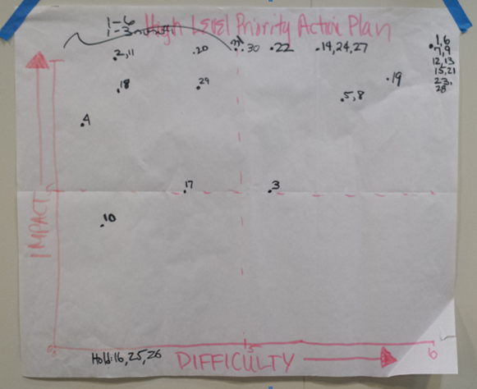

Slide 34
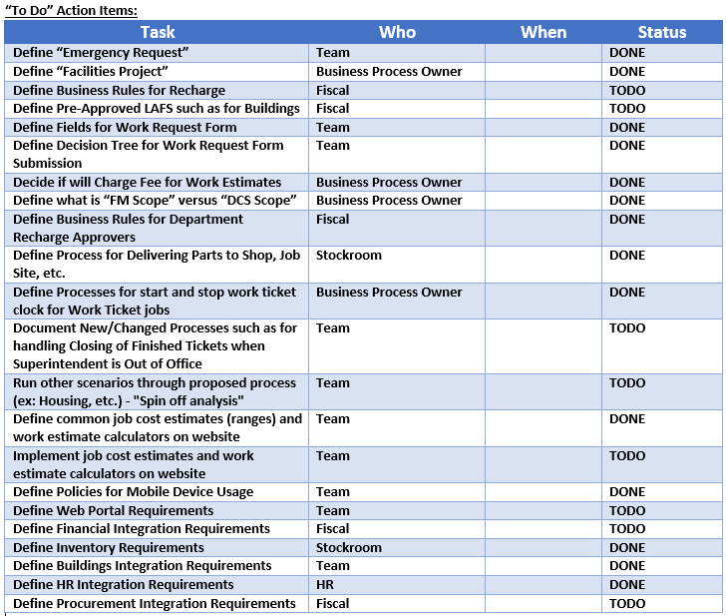
NOTE: The “To Do” items listed here were numbered and corresponded to the numbers on the “High Level Priority Action Plan” chart.

Slide 35
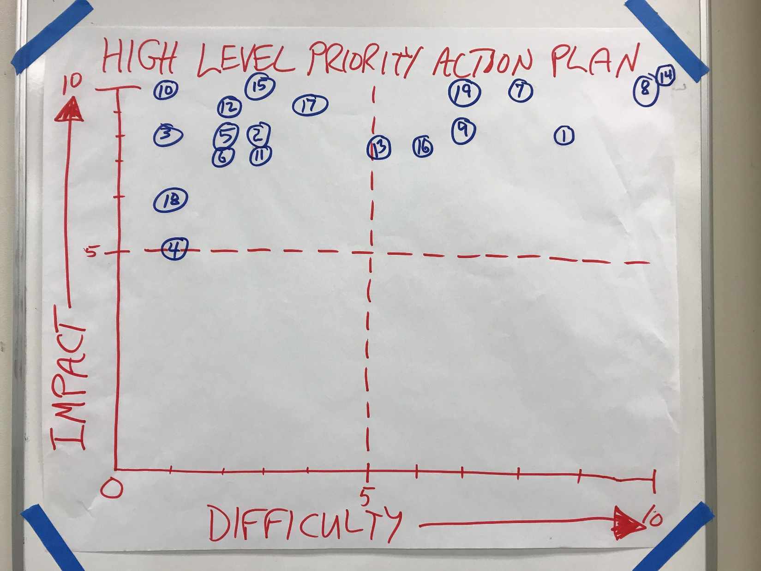

Slide 37
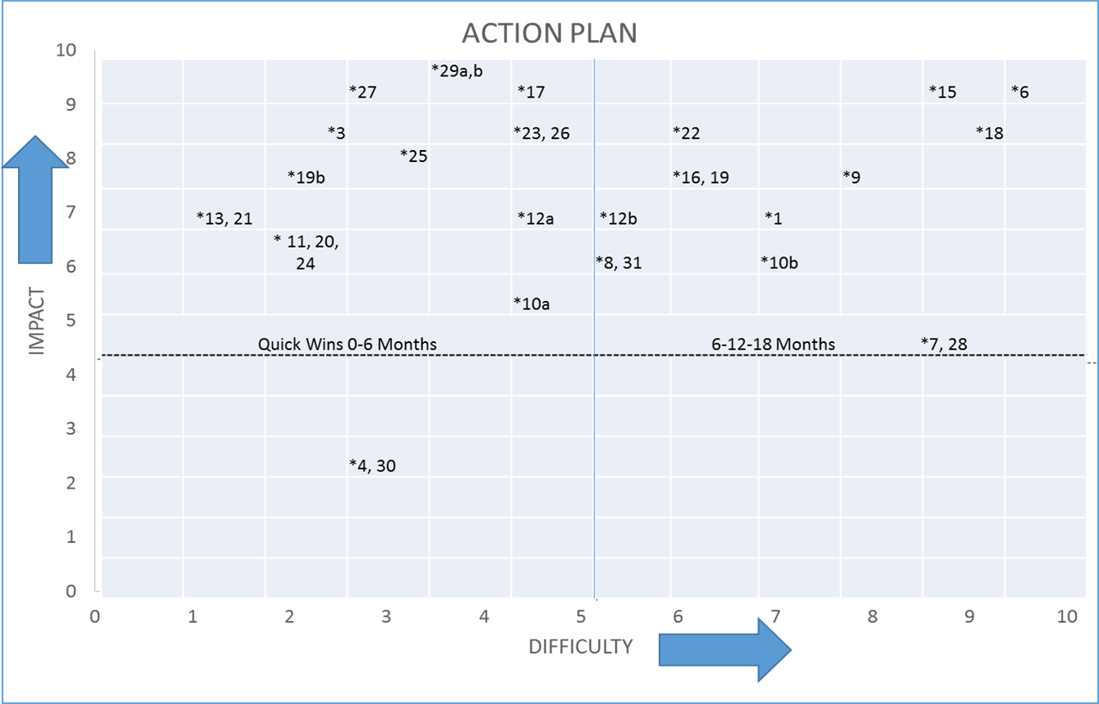

Slide 38
Kaizen – Day 3…
Closing Summary
Identify the Kaizen “Champion”
Plan to Communicate with the Kaizen Team at Least Once Per Month to Review the Status of the Action Plan
Remember that Kaizen is a Continuous Process.
May Schedule Another Event in Two Years to Review New Process Implementation
Be Agile (Flexible) and Have Fun!

Slide 39
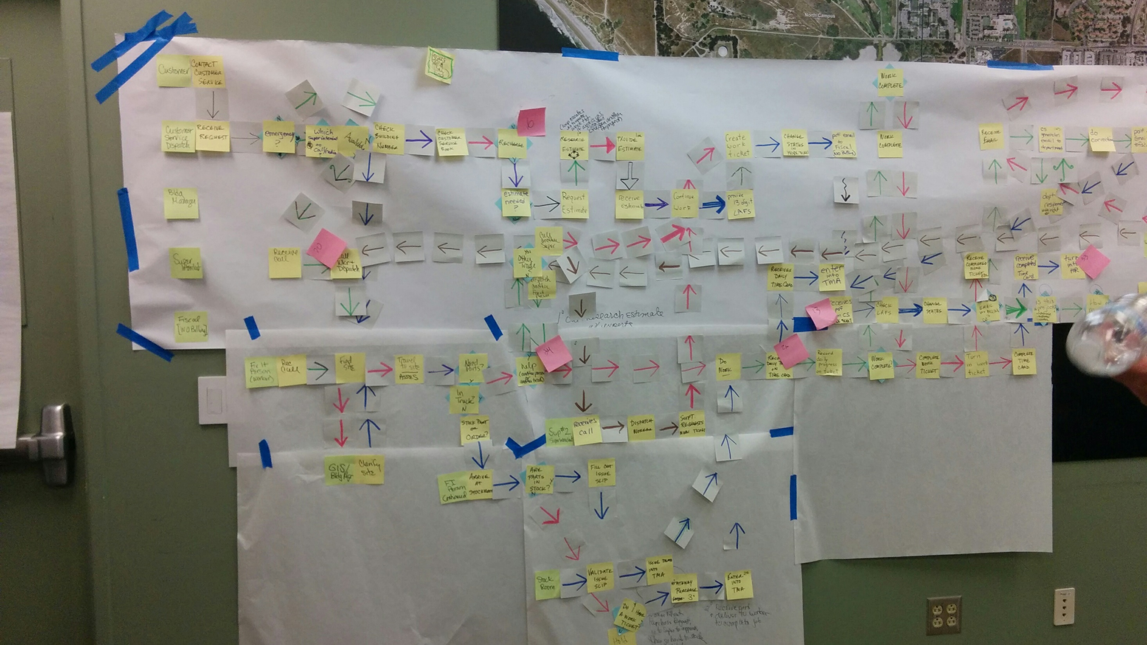
Kaizen Event

Slide 40
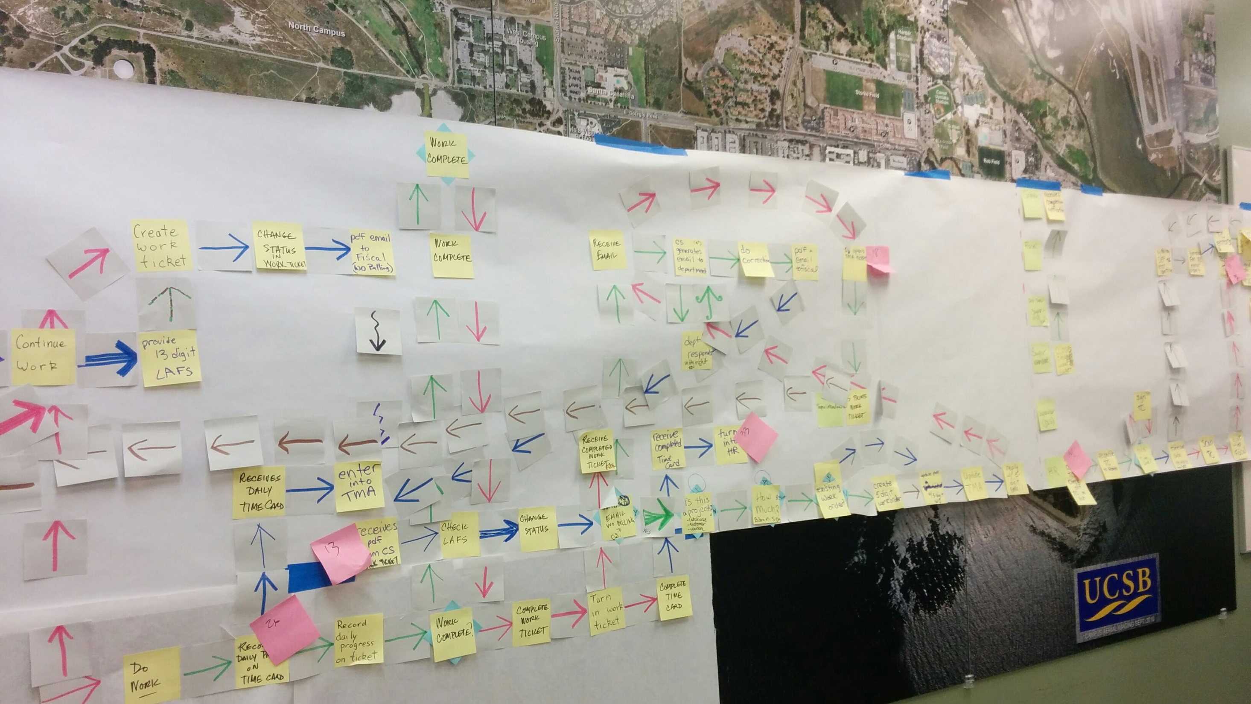
Kaizen Event

Slide 41
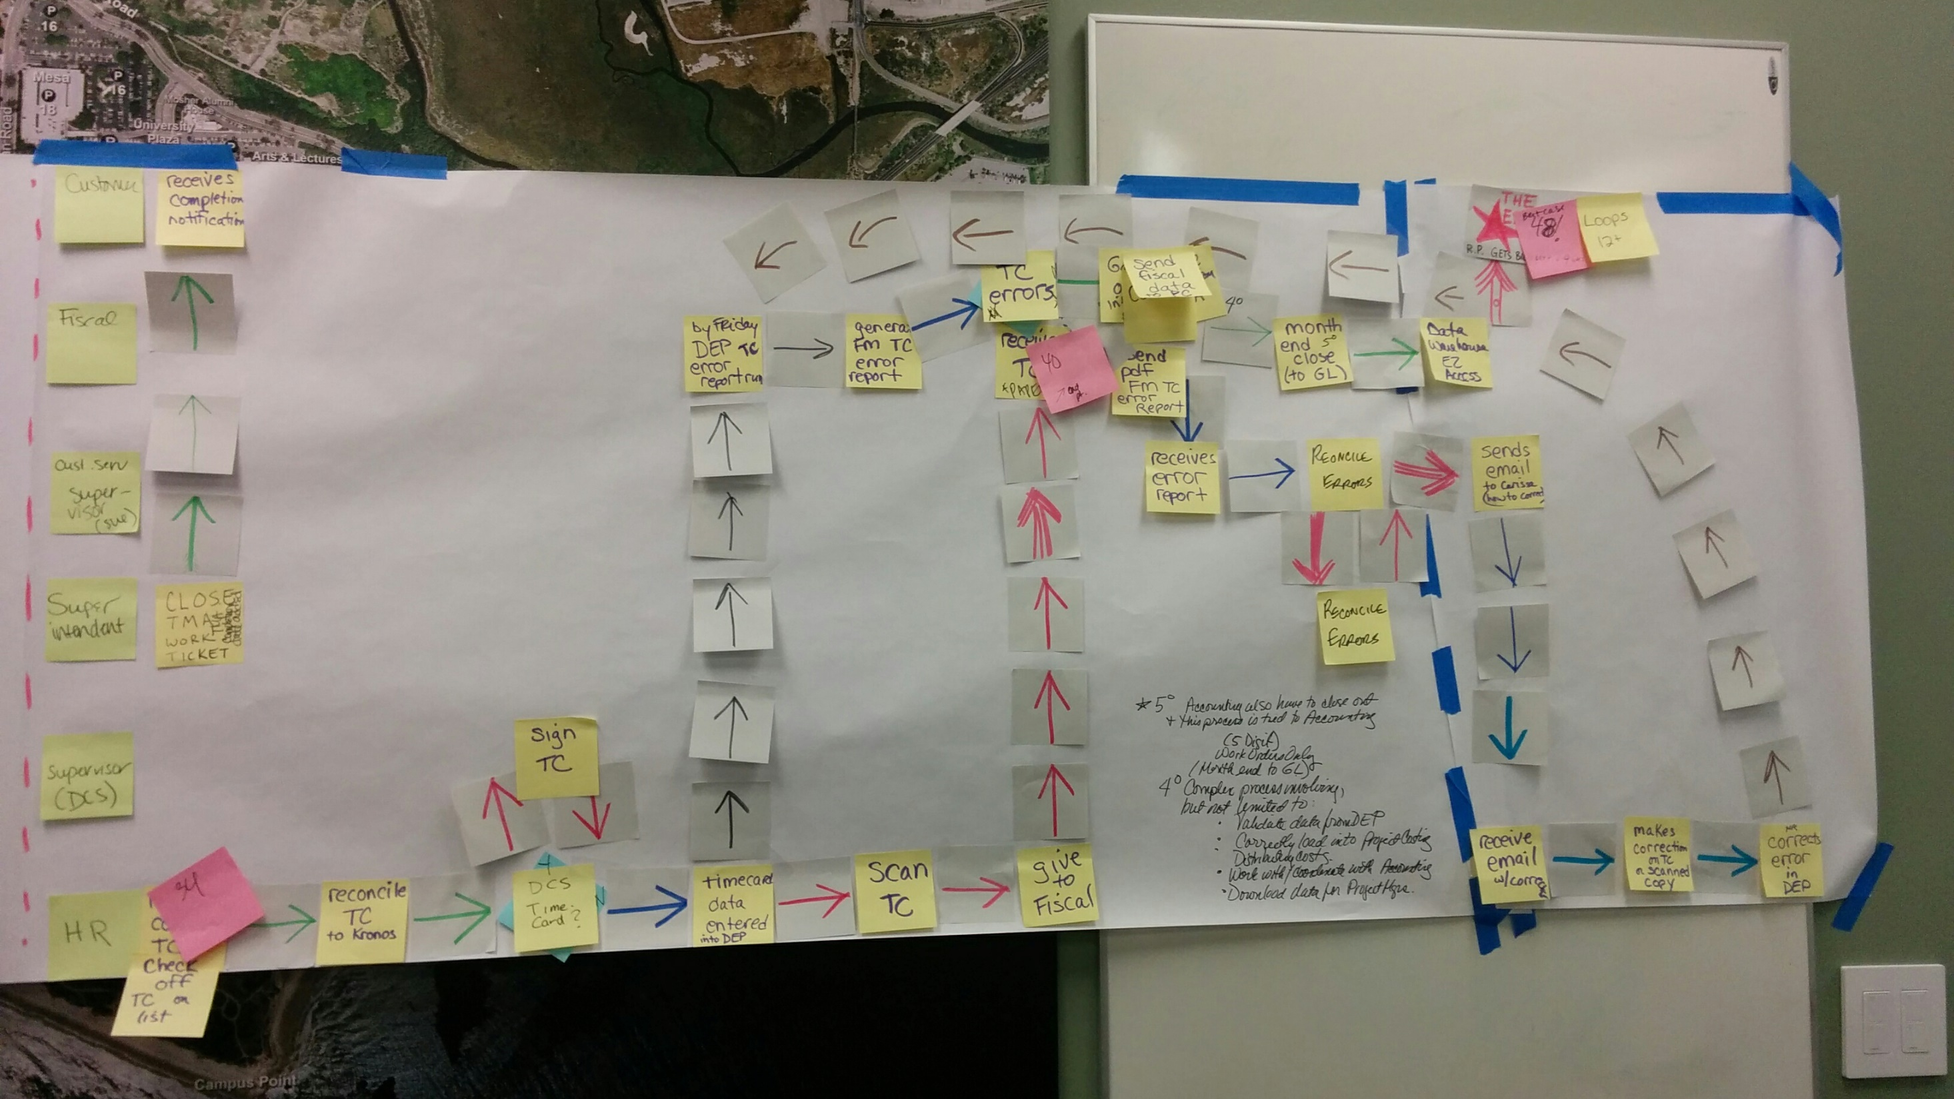
Kaizen Event

Slide 42
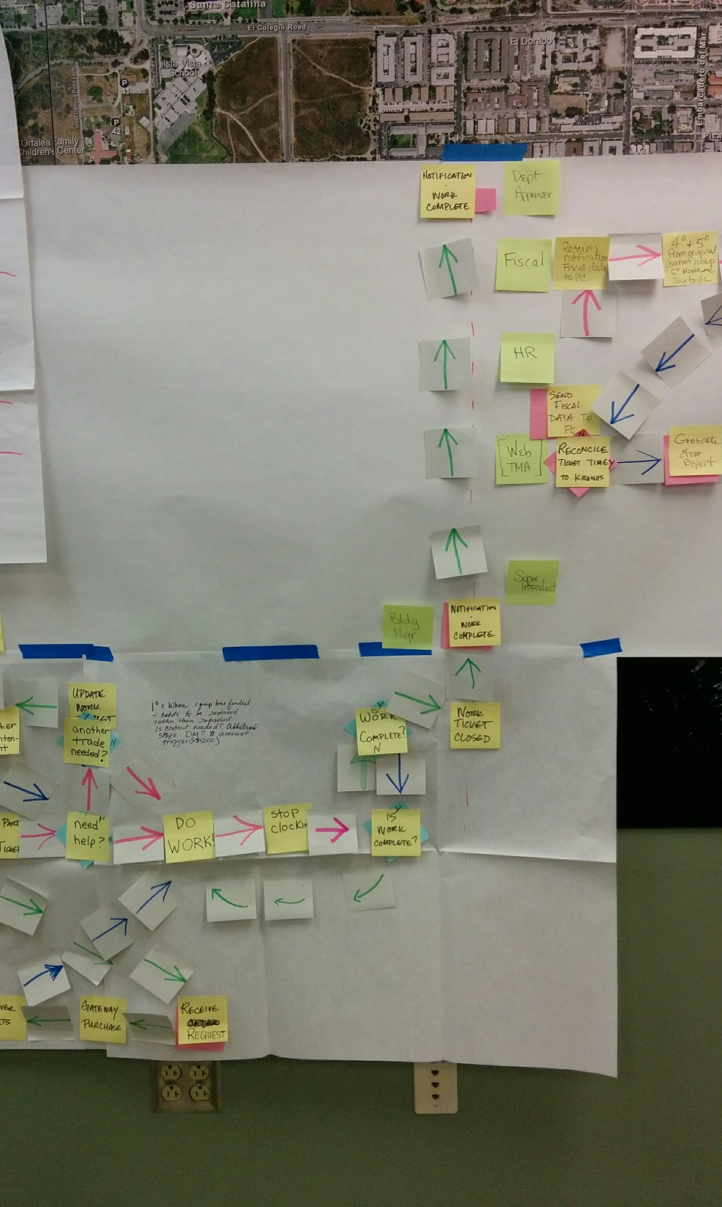
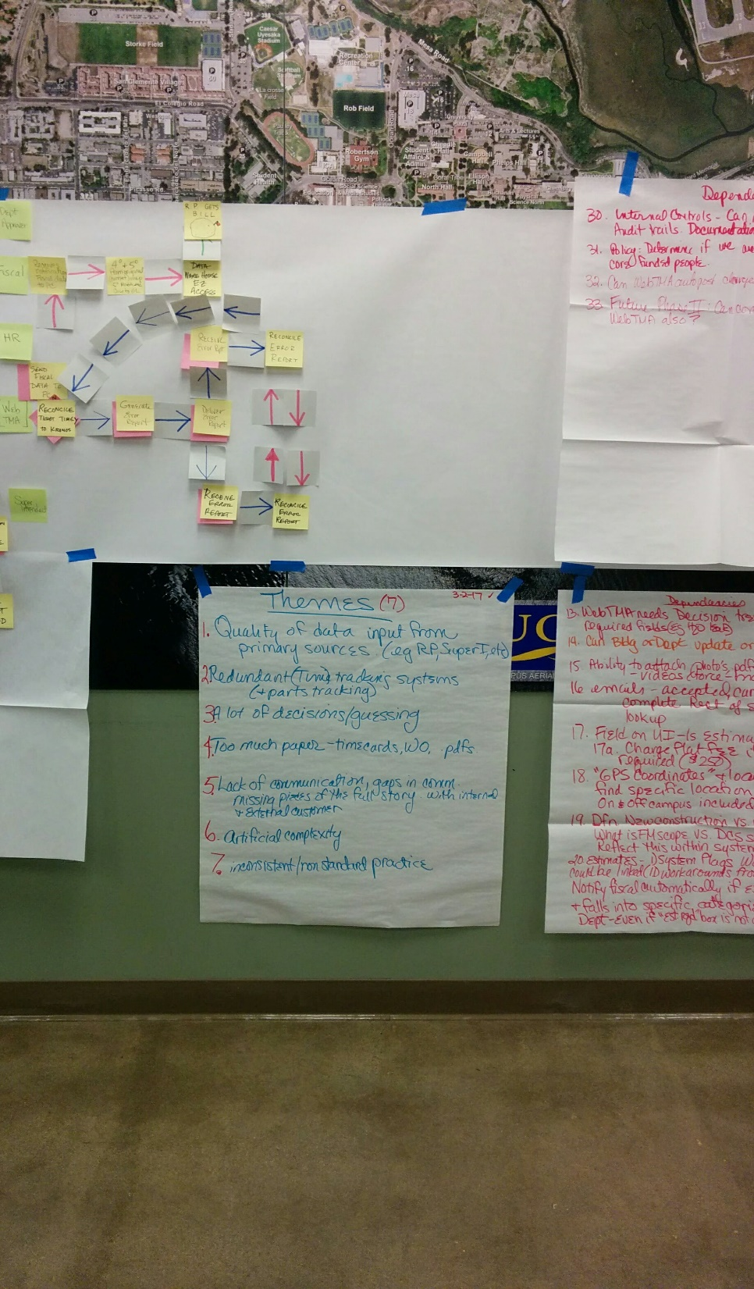
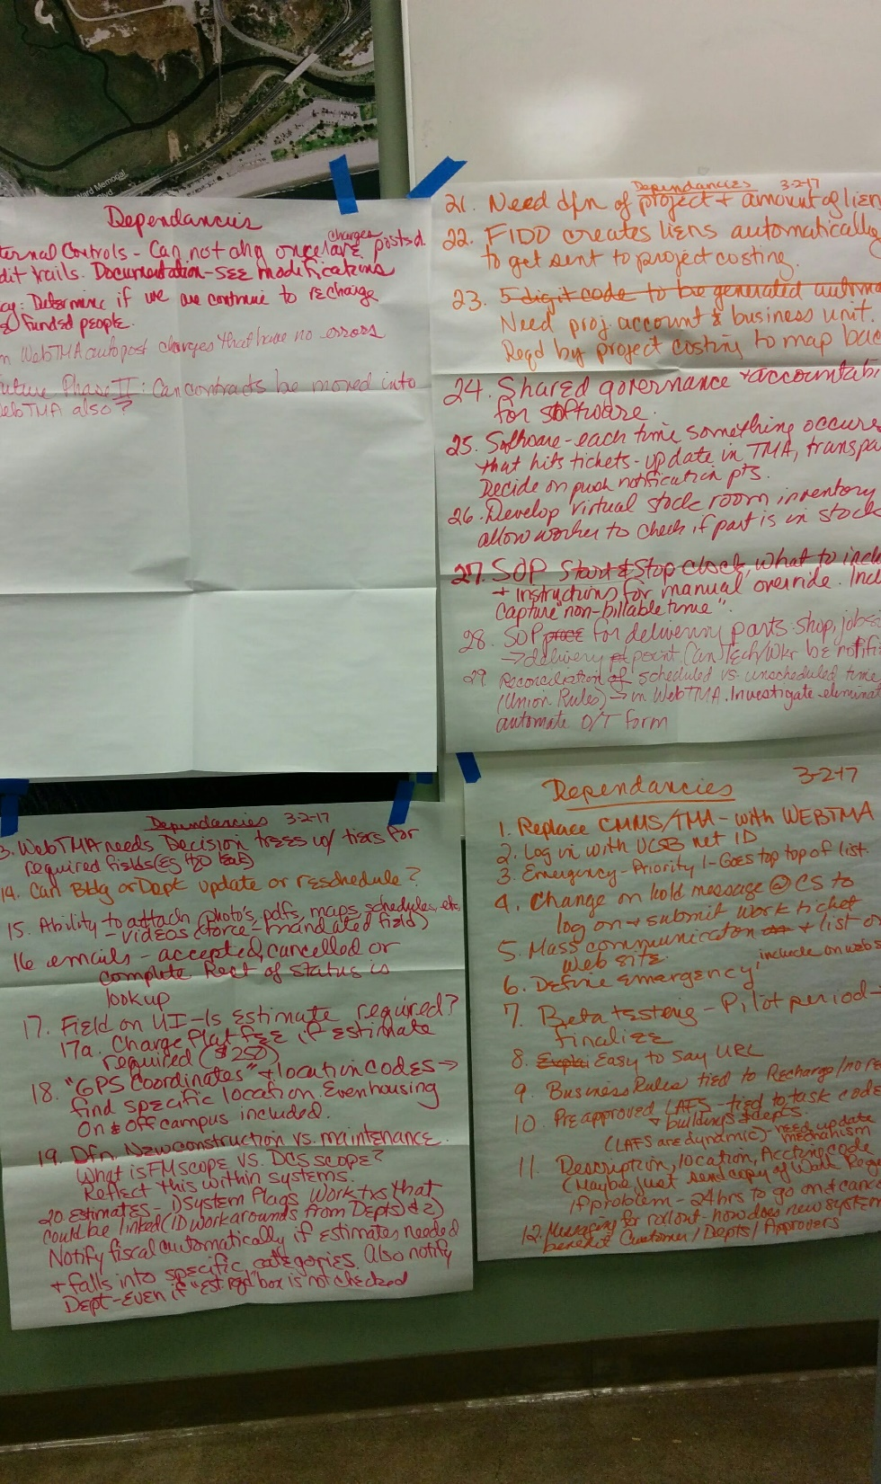
Kaizen Event

Slide 43
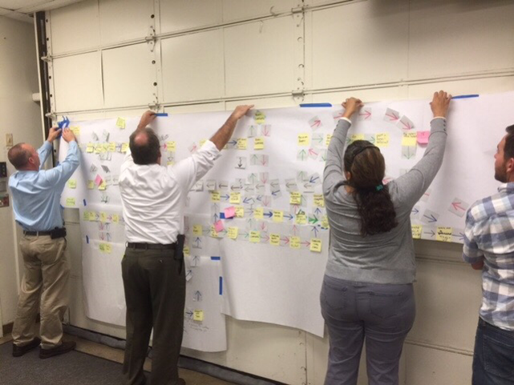
Kaizen Event

Slide 44
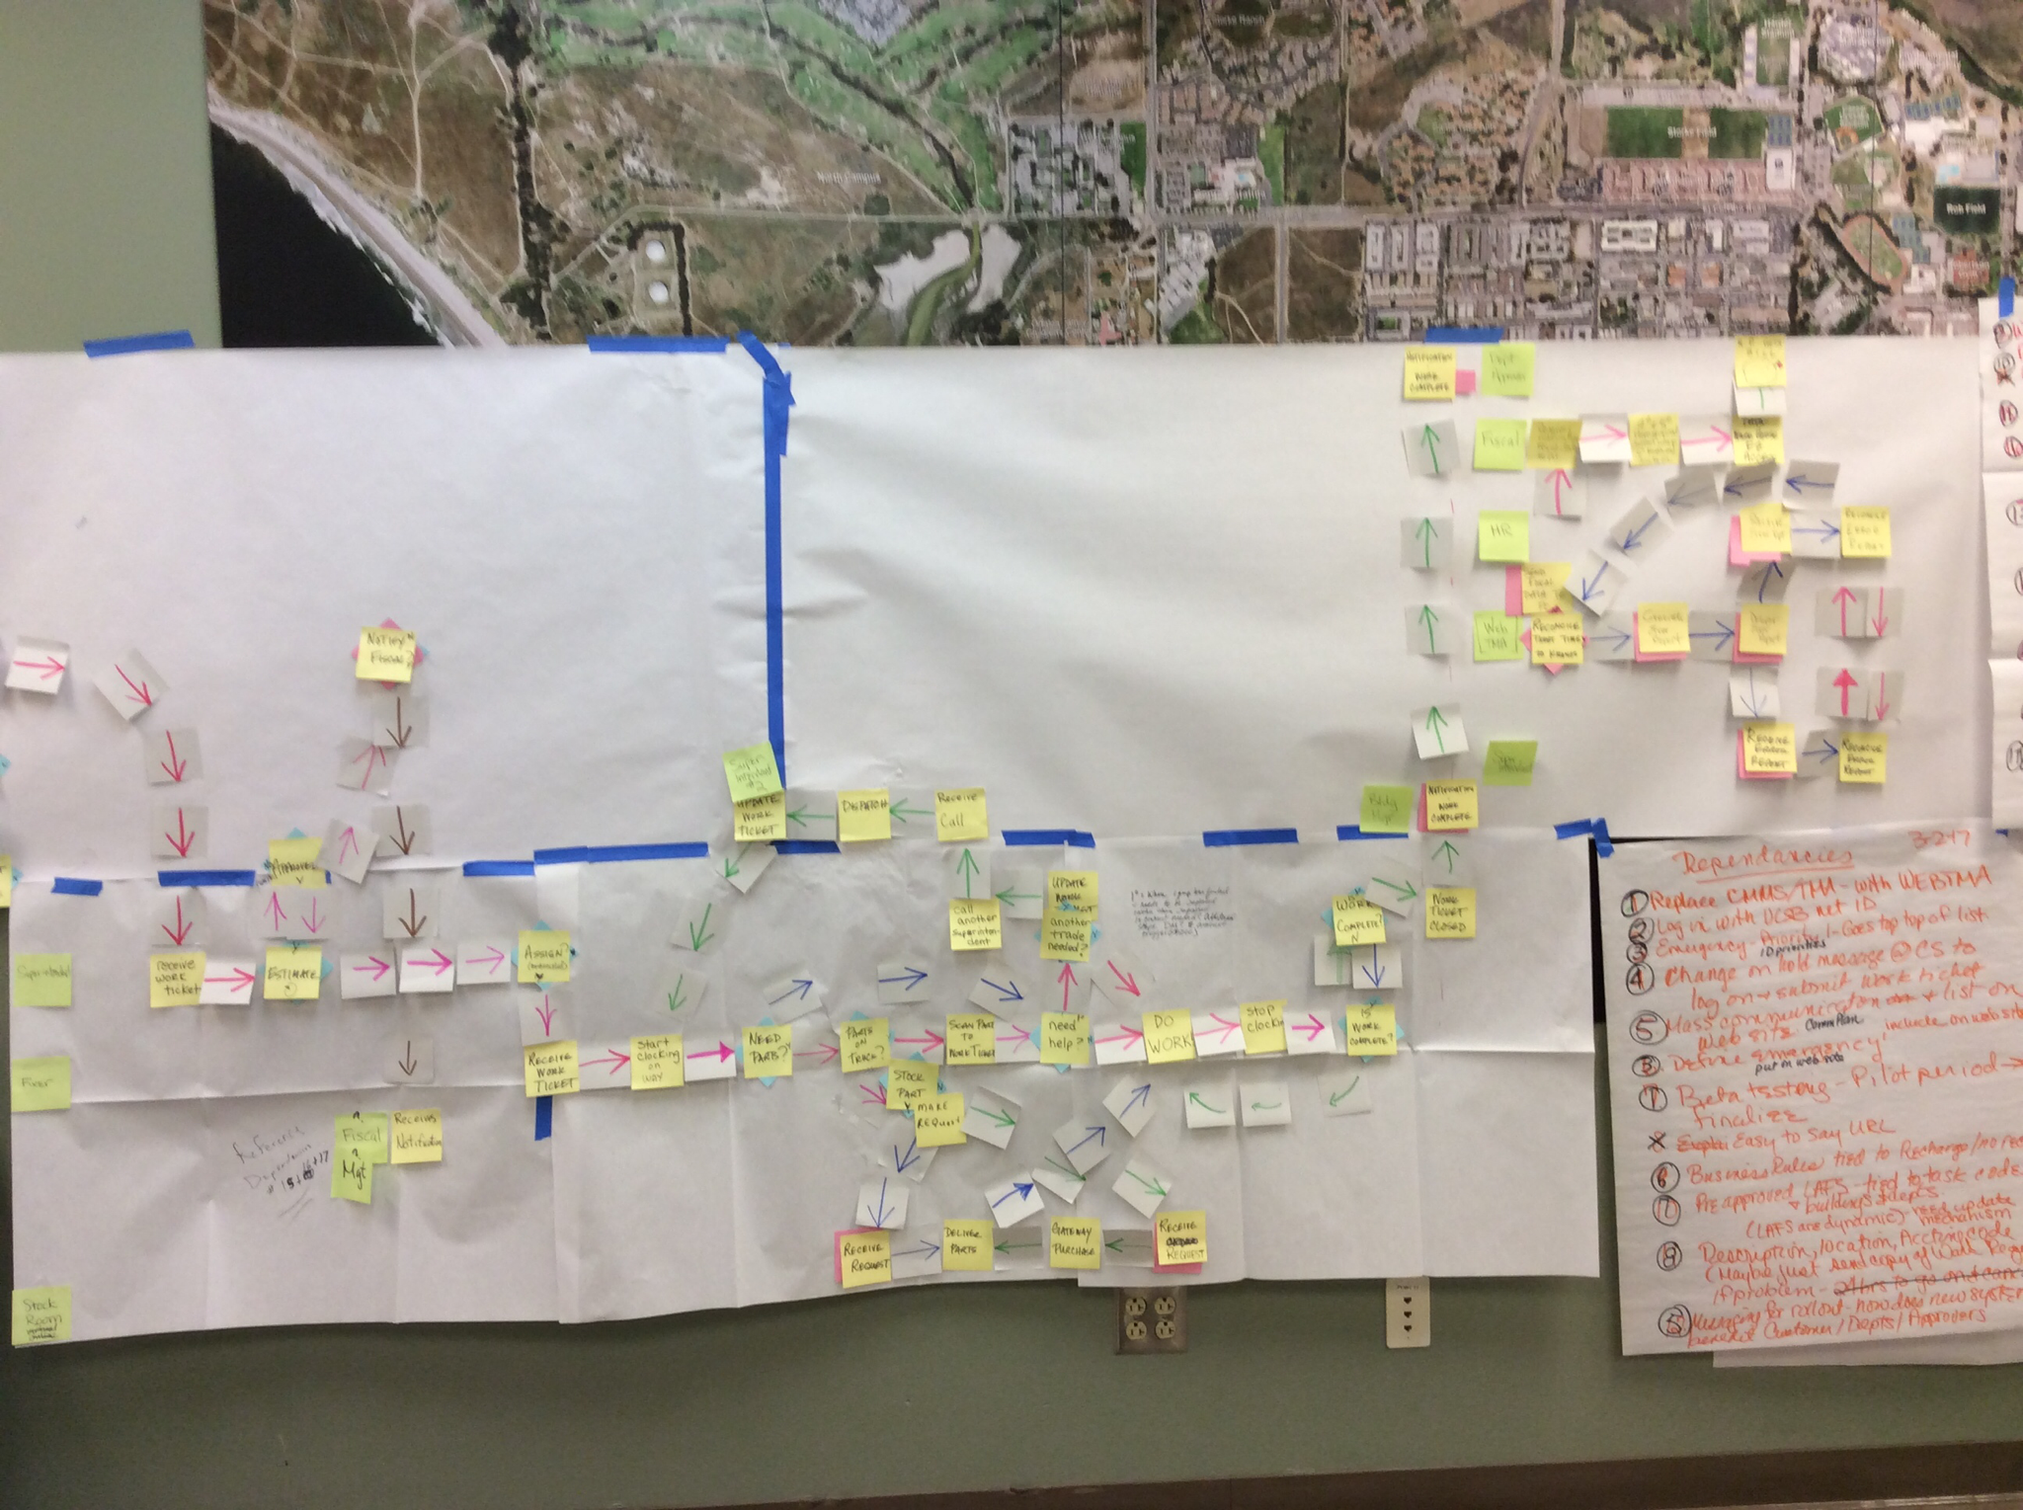
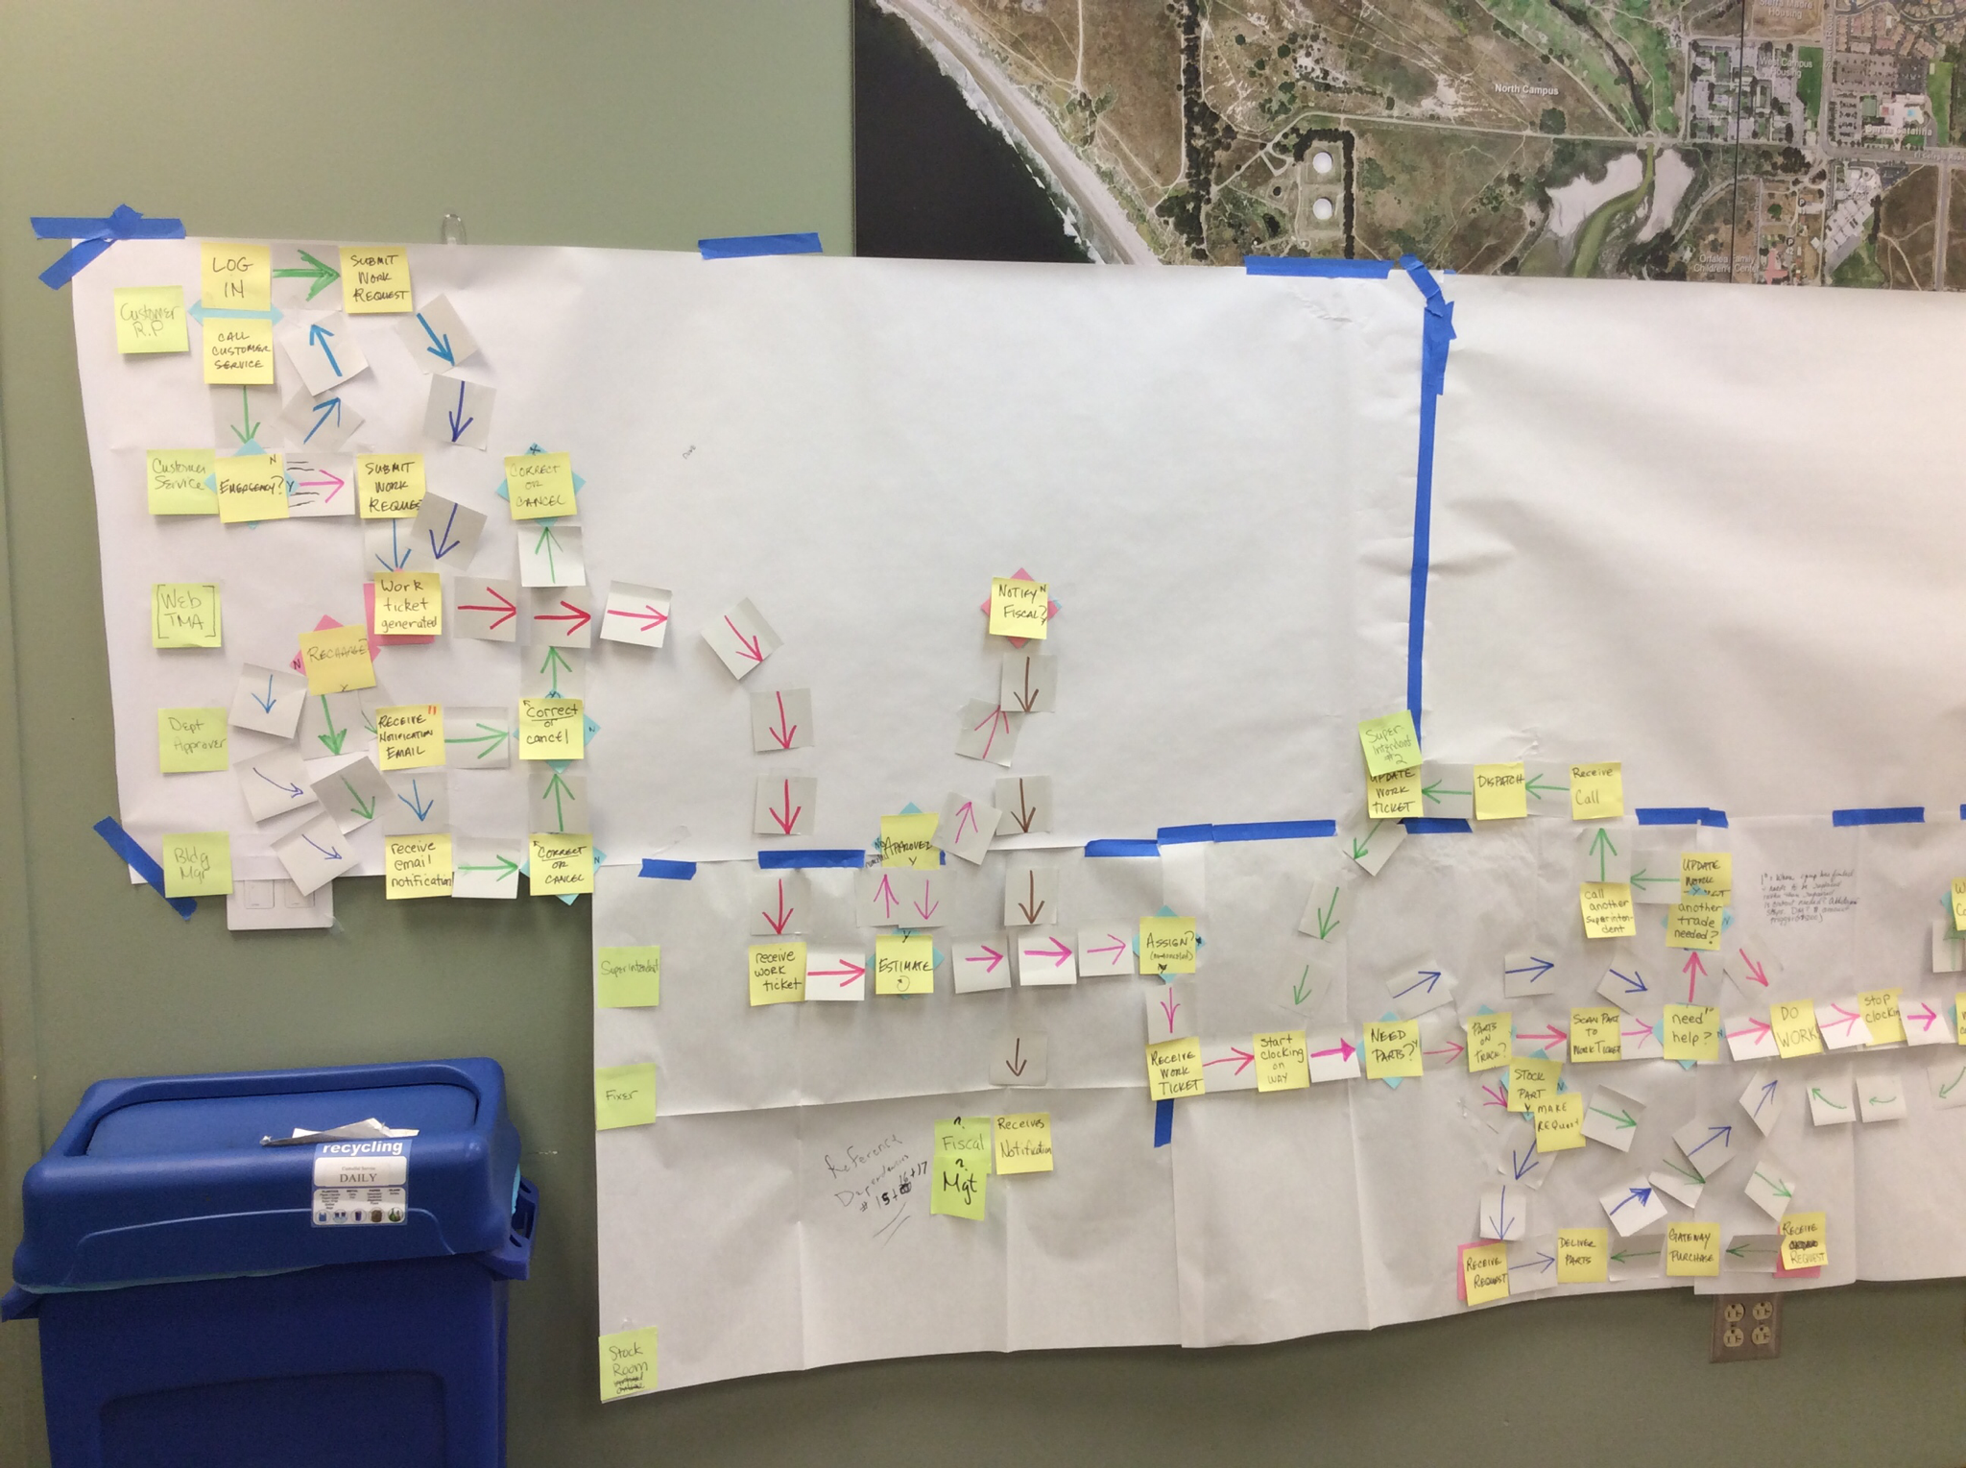
Kaizen Event

Slide 45
Kaizen
What It Is
Why It’s Important
How It Works
How We Did It

Slide 46
References
[1] https://in.kaizen.com/about-us/definition-of-kaizen.html
[2] https://www.leanproduction.com/kaizen.html
[3] https://in.kaizen.com/about-us/definition-of-kaizen.html
[4] https://www.isixsigma.com/methodology/kaizen/kaizen-easiest-fastest-way-improve-office-processes/
[5] Customer Service Advantage, Inc., Escondido, CA

Slide 47
Kaizen
“Good Change!”
Questions?
Gary Fix
Associate Director IT DFSS
University of California, Santa Barbara
gary.fix@ucsb.edu
2018-Aug-15

Slide 48
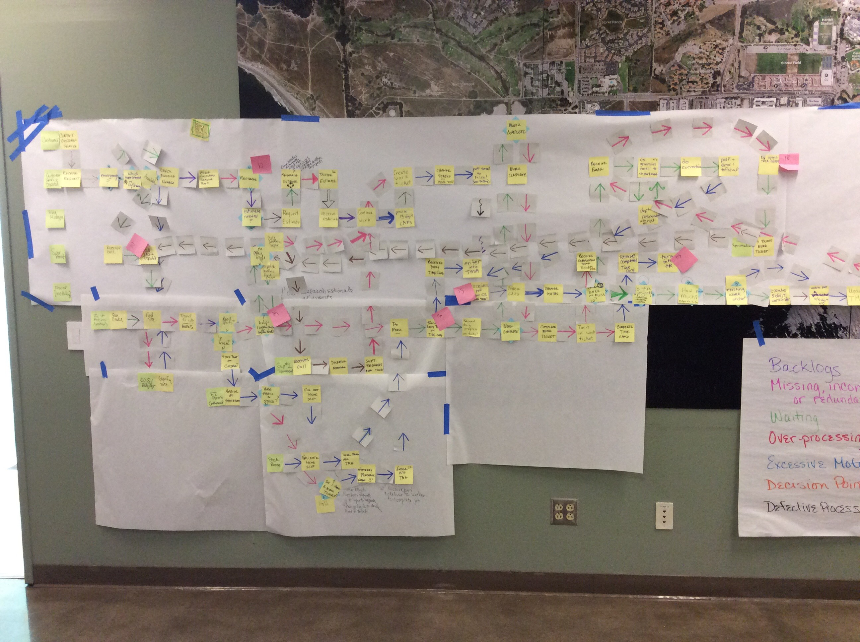

Slide 49
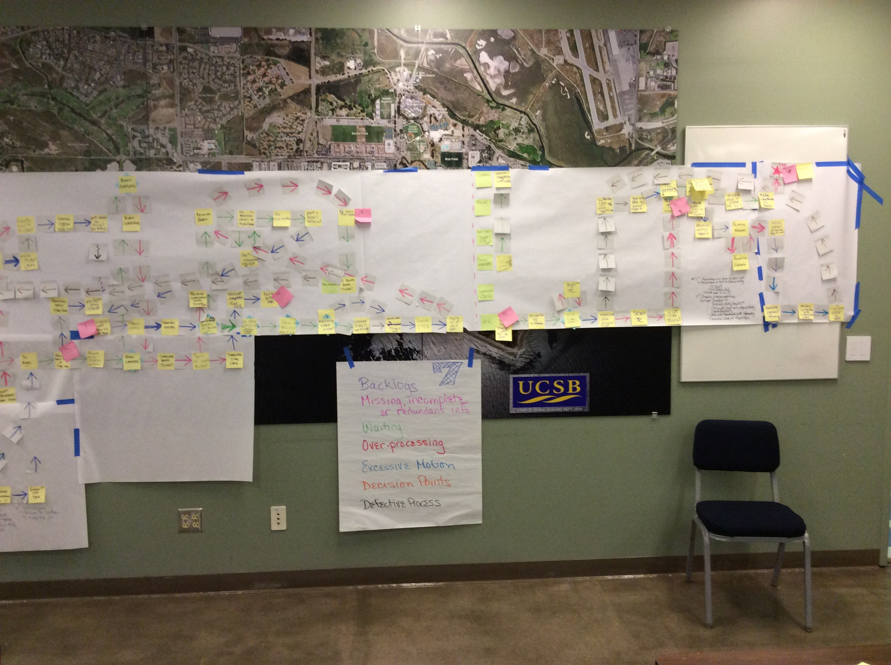

Slide 50
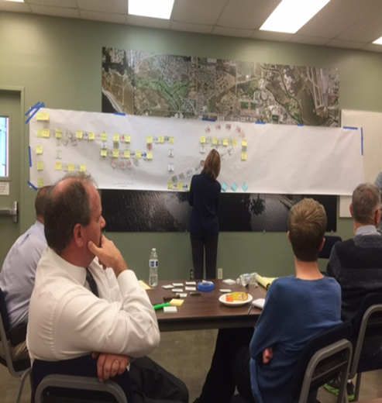
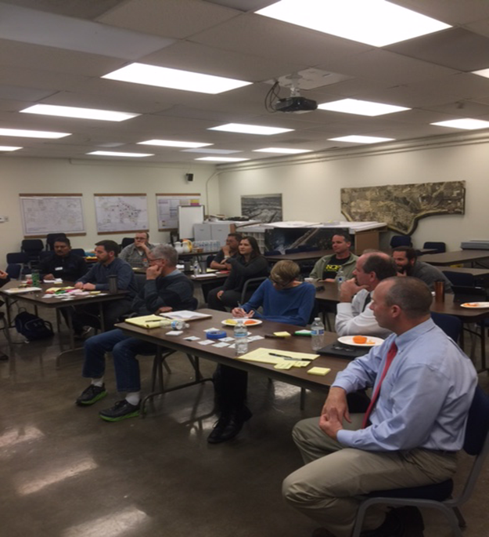

Slide 51
