Slide 1
An Inventory That Updates Itself
Integrating Jamf Pro and LDAP to solve complex problems and reduce IT workload

Slide 2
What To Expect
A solution to the Adobe problem using Jamf Pro
An introduction to two new tools from Santa Cruz

Slide 3
What
Where
Who

Slide 4
What
Type of device
Specifications
Status

Slide 5
Where
On campus or off
Wired or Wireless
Subnet or Building

Slide 6
Who
Name
Office Location
Phone number
Type (Faculty, Staff)
Status

Slide 7
Traditional Manual Inventory
Enter Computer into spreadsheet or other database
Link computer to location
Link computer to person
Keep up to date as things change

Slide 8
Problems
All work is manual
Its out of date the moment something changes in your environment
Likely has no accountability
Prone to errors in data entry

Slide 9
The Intelligent Alternative
One simple work task to maintain
Knows Who, What, Where automatically
Updates itself in real time leveraging existing data repositories
Tells you far more than just where you last saw the equipment

Slide 10
Distributing Adobe
User registers their computer
The system creates a federated ID for the user
The system assigns an Adobe Named User License to the user’s federated ID

Slide 11
Revoking Adobe
User’s status no longer meets eligibility or is no longer registered to any computers
The system removes the entitlement from the user’s federated ID

Slide 12
Necessary Components
Jamf Pro Environment
LDAP based directory
Jamf Pro Dynamic Static Group Manager
Jamf Pro DSG Adobe Integration

Slide 13
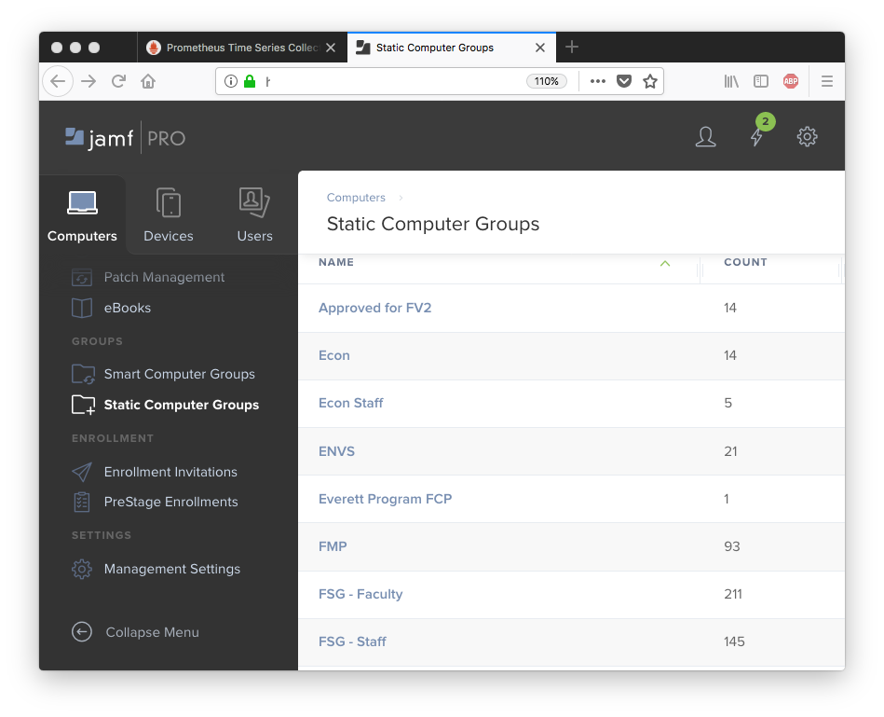
Jamf Pro

Slide 14
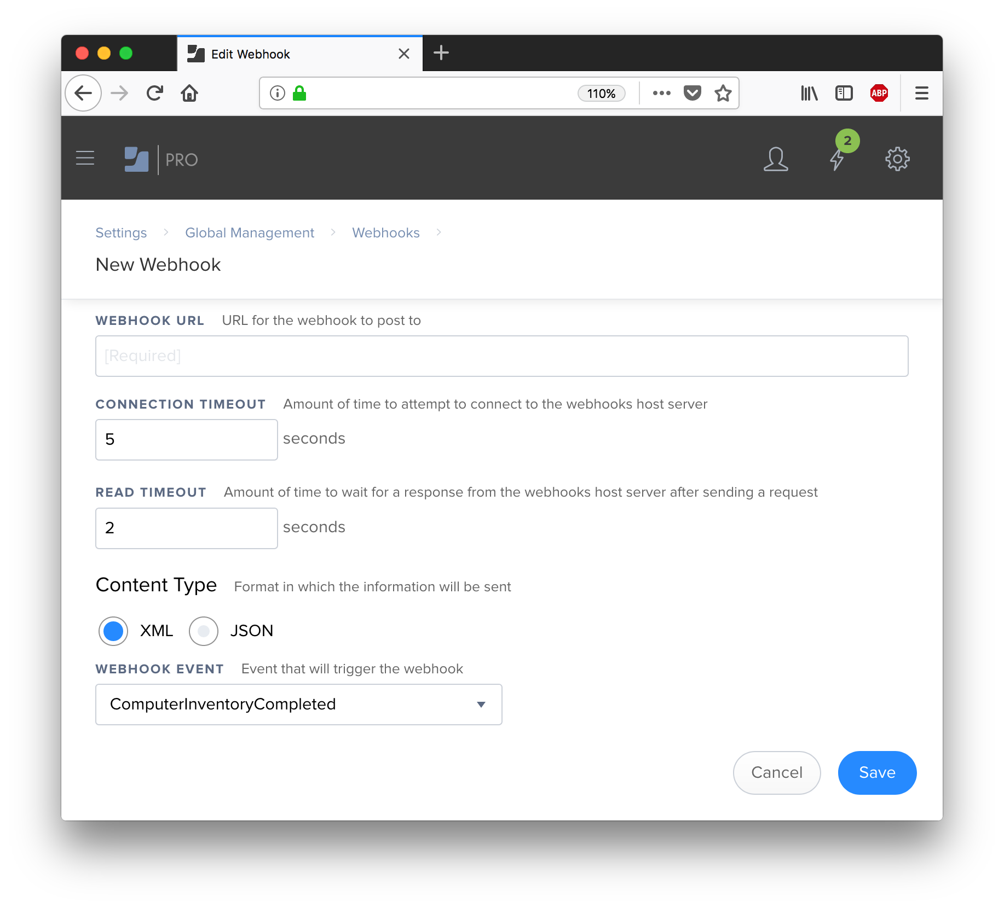

Slide 15
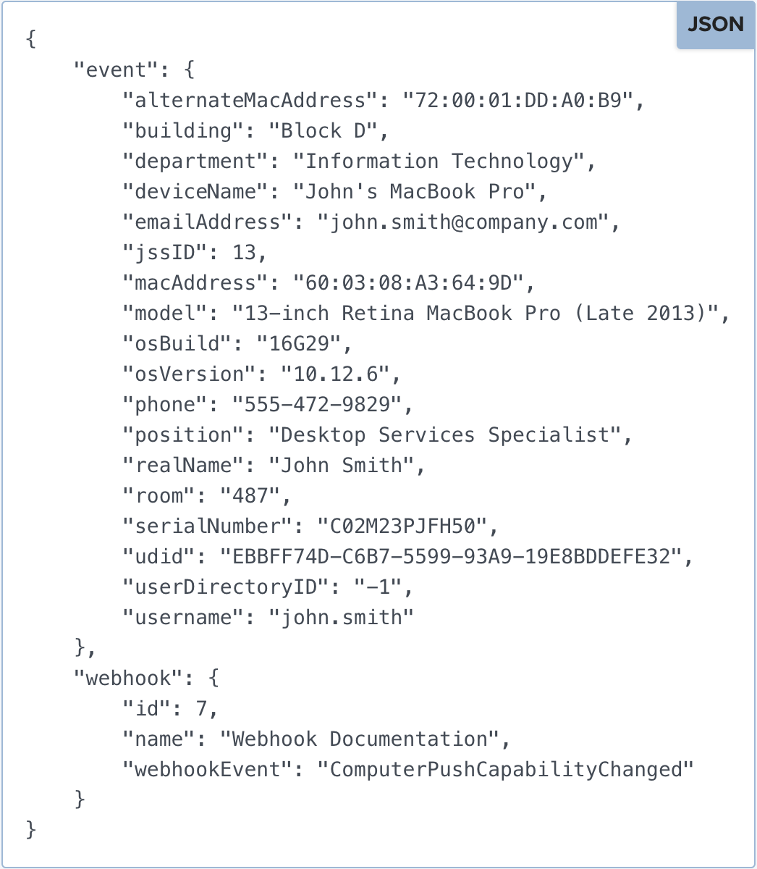

Slide 16
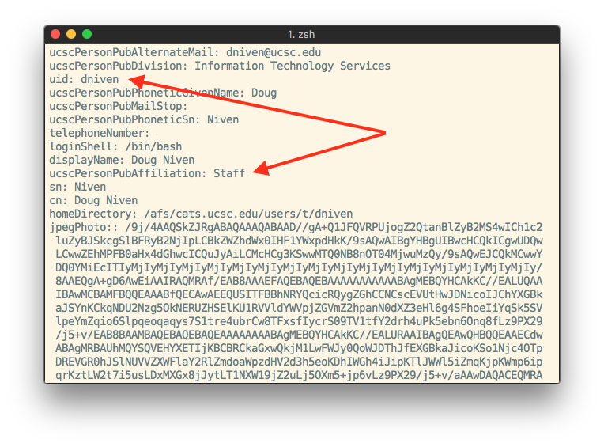
LDAP

Slide 17


Cirrup
Manages your Jamf Pro Dynamic Static Groups
Binary server executable written in Go

Slide 18

Jamf Pro
MDM Server
LDAP
(directory)
Cirrup
Your devices in the field

Slide 19

Mudwork
Integrates with Jamf and Adobe
Synchronizes entitlements with a Jamf Pro DSG
Binary server executable written in Go

Slide 20

LDAP
(directory)
Mudwork
Adobe API
Cirrup
Jamf Pro
Your devices in the field

Slide 21
Development Process
Identify desired outcome
List required functions (progress checklist)
“Dank” code vs. DRY code

Slide 22
Go is an open source programming language that makes it easy to build simple, reliable, and efficient software.

Slide 23
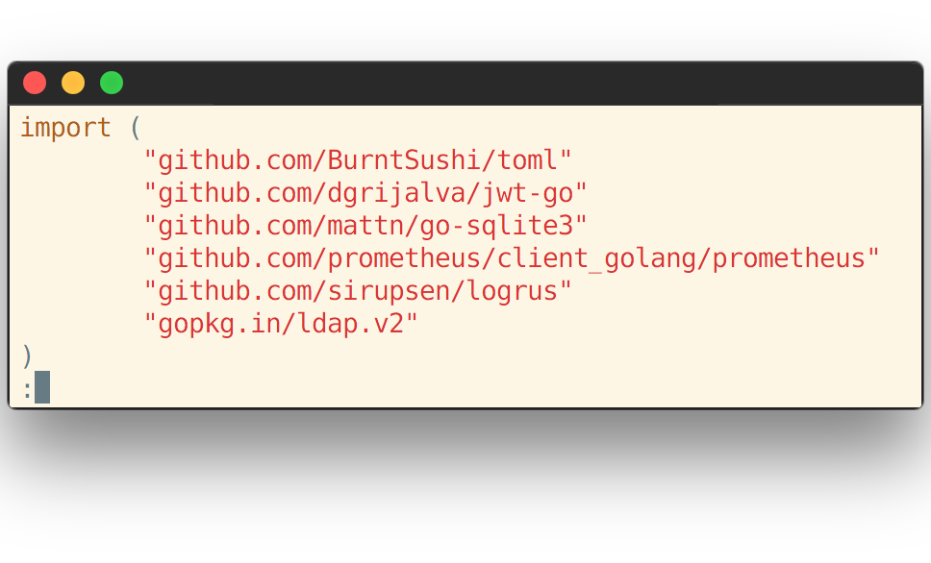
Technologies

Slide 24
Logrus

Slide 25
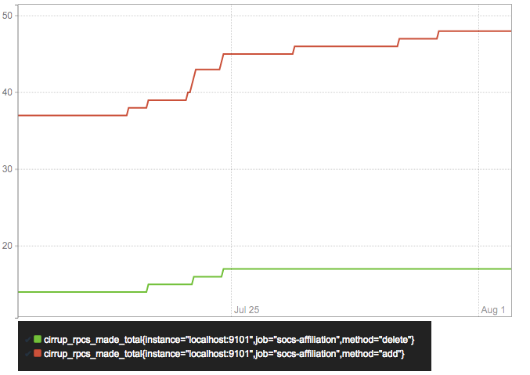
Prometheus

Slide 26
Alternatives
Adobe’s User Sync Tool (python)
Uploading CSV’s/Adobe Admin Console (manual)
Facebook CPE-style endpoint based python scripts

Slide 27
“Typically, an enterprise runs the tool as a scheduled task, in order to periodically update both user information and group memberships in the Adobe User Management system with the current information in your enterprise LDAP directory.”
–Adobe User Sync documentation

Slide 28
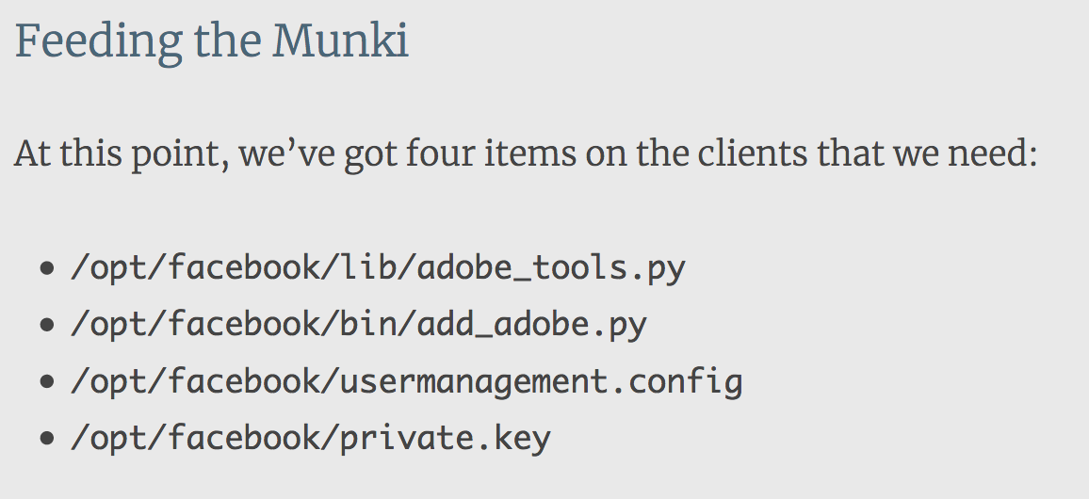
Facebook CPE-add_adobe

Slide 29
Review
Cirrup/Mudwork | Adobe User Sync | Endpoint Scripts
Binary executable | Python script | Python script
Event listener | Scheduled execution | User initiated
Resources located on one server | Resources located on one server | Resources located on each endpoint
Requires Jamf & LDAP | Works with LDAP, AD, Okta | Requires Munki & AD

Slide 30
Future Plans
Improve and refactor
Turn existing tools into connectors a la user-sync
Windows support

Slide 31
Acknowledgements
Hilary Hamm (UCSC Client Services and Support)
SocSci IT (UCSC Academic Divisional Computing)
Nick McSpadden (Facebook Cloud Platform Engineering)

Slide 32
Start Using DSG’s!
Cirrup github.com/cosmouser/cirrup
Mudwork available for use by UC only
Please contact me for details
cosmo@ucsc.edu

