Slide 1



Application Whitelisting and Your Managed Desktops
Aakash Shah / Jeremy Paje
August 15, 2018

Slide 2
About Us
Application Whitelisting and Your Managed Desktops
Jeremy Paje
Manager, Desktop Support Services
Office of Information Technology
Aakash Shah
Systems Engineer, Windows Services Group
Office of Information Technology

Slide 3
Application Whitelisting and Your Managed Desktops
Overview
What is Application Whitelisting?
Reasons for implementing
Setting up AppLocker policies
Troubleshooting AppLocker
Challenges
Questions

Slide 4
Application Whitelisting and Your Managed Desktops
Question for you

Slide 5
Common security layers
Application Whitelisting and Your Managed Desktops
Antivirus
Firewall (software)
Firewall (hardware)
Patching
IPS
*Application whitelisting

Slide 6
What is Application Whitelisting?
Application Whitelisting and Your Managed Desktops
Ways to control application execution
  Trust Centric – Default Deny, allow only files on whitelist to run. (recommended)
  Threat Centric – Default Allow, block files on blacklist from running.

Slide 7
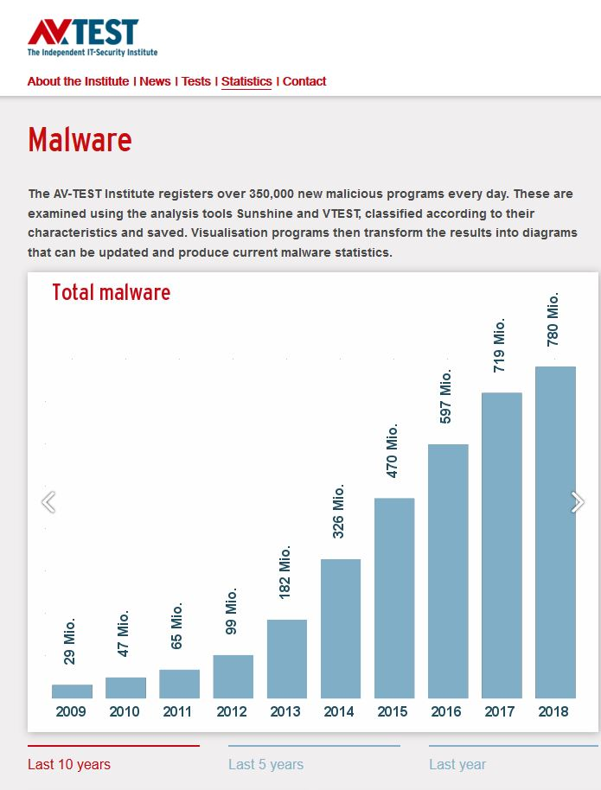
Why should we care?
Application Whitelisting and Your Managed Desktops

Slide 8

Problems Before Application Whitelisting
Application Whitelisting and Your Managed Desktops
(Even on patched machines…even without admin rights)

Slide 9
Application Whitelisting
Microsoft AppLocker
Windows 10 Enterprise/Education, Windows 7 Enterprise
Group Policy

Slide 10
First things first…
Test, test, test...

Slide 11
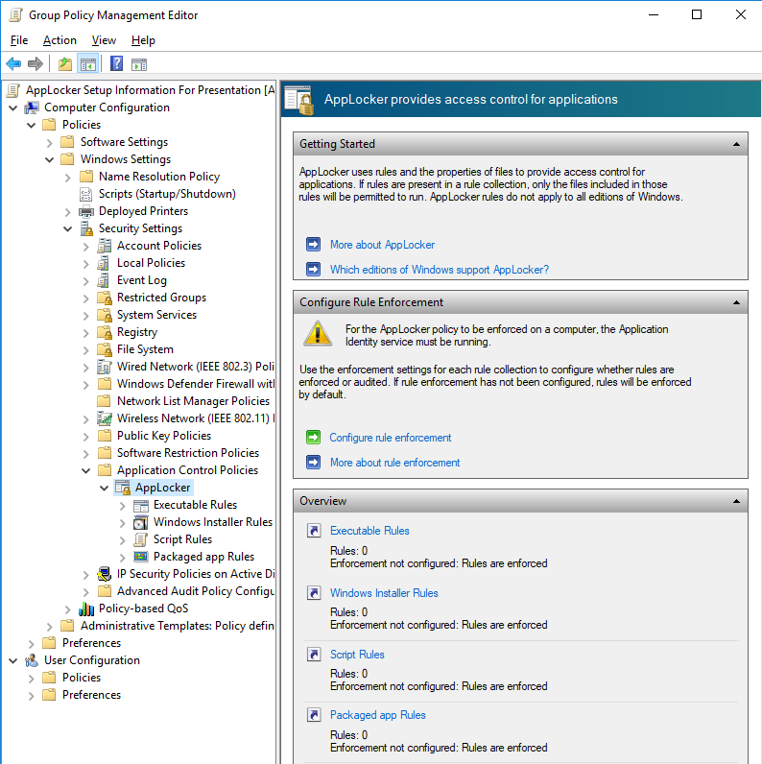
Where Are The AppLocker Policies?
Application Whitelisting and Your Managed Desktops

Slide 12
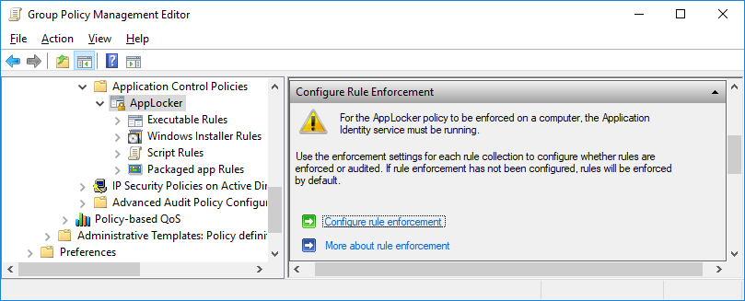
Configure Rule Enforcement
Application Whitelisting and Your Managed Desktops

Slide 13
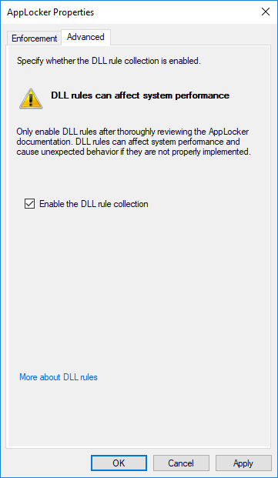
Enable DLL Rules
Application Whitelisting and Your Managed Desktops

Slide 14
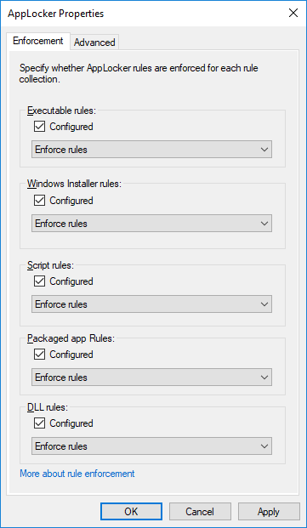
Application Whitelisting and Your Managed Desktops

Slide 15
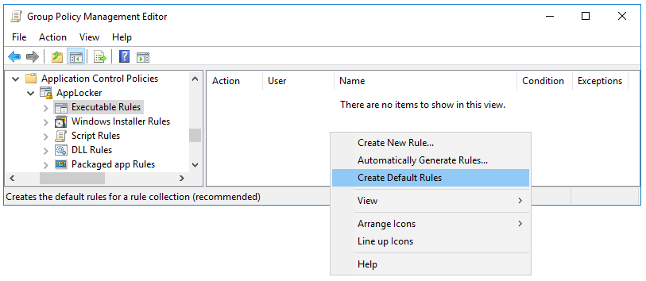
Create Default Rules
Application Whitelisting and Your Managed Desktops

Slide 16
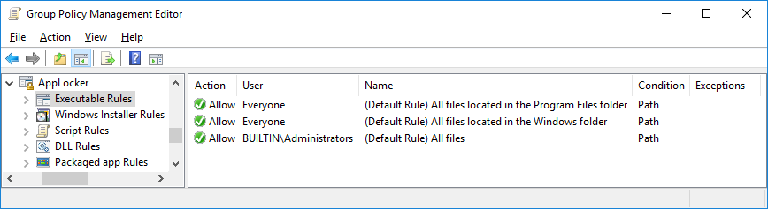
Default Rules View
Application Whitelisting and Your Managed Desktops

Slide 17
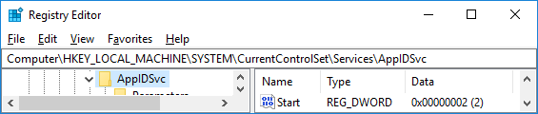
Enable Application Identity Service

Slide 18
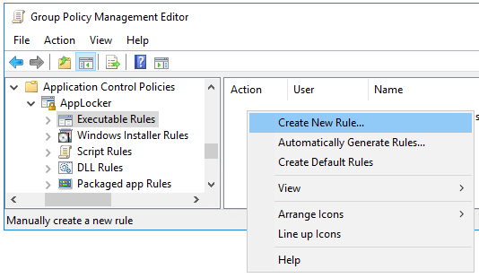
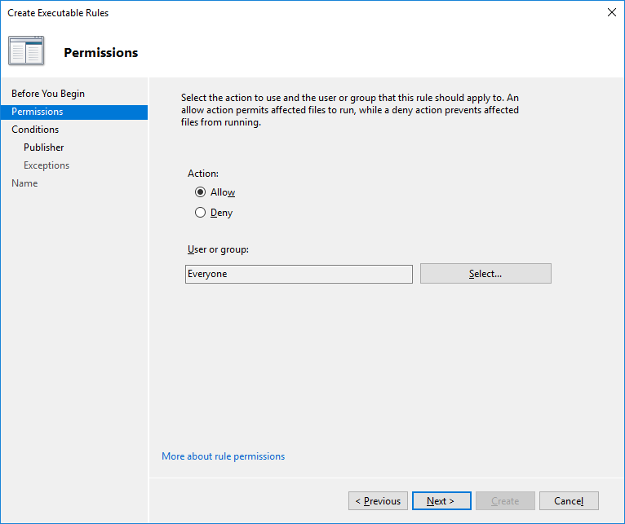
Adding Custom Rules
Application Whitelisting and Your Managed Desktops

Slide 19
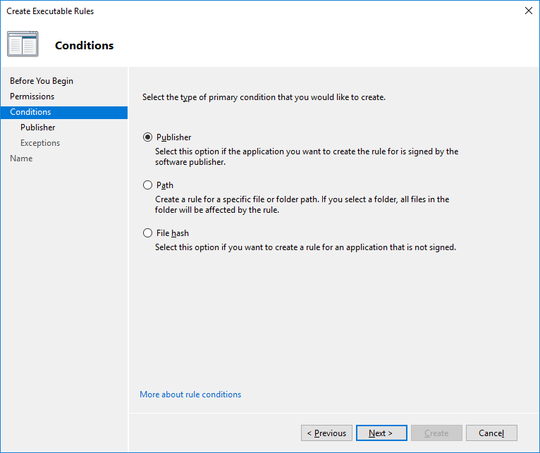
Application Whitelisting and Your Managed Desktops

Slide 20
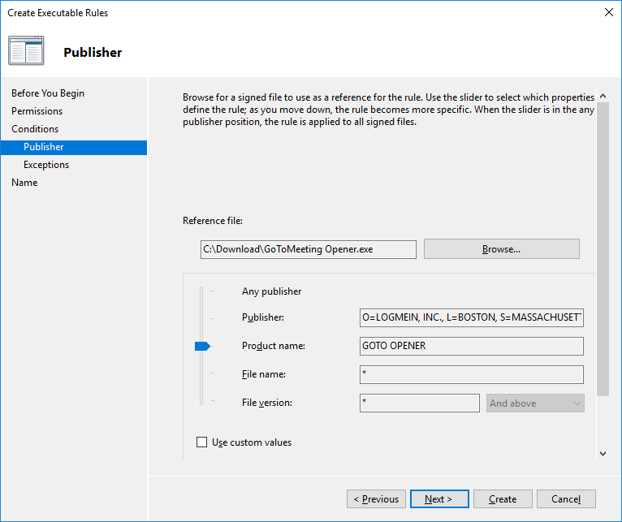
Application Whitelisting and Your Managed Desktops

Slide 21
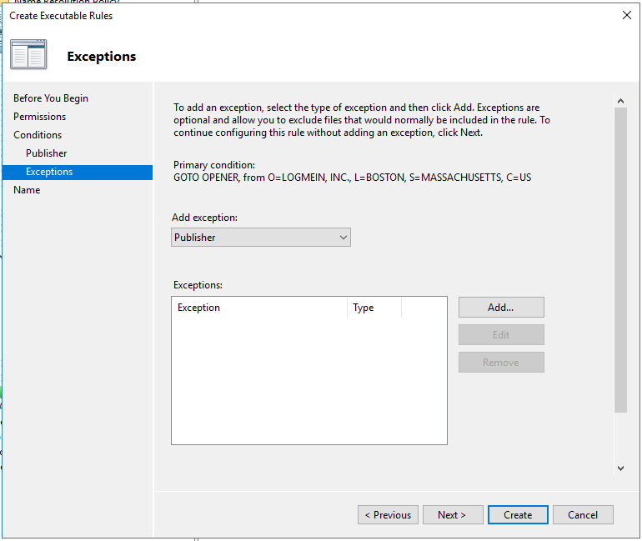

Slide 22
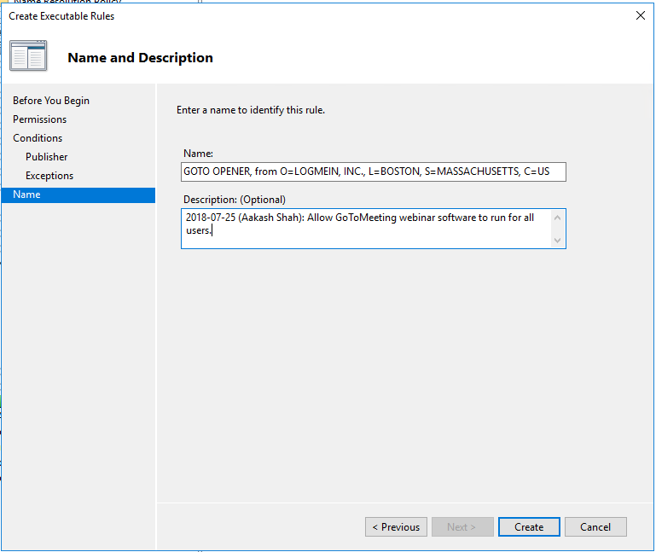

Slide 23
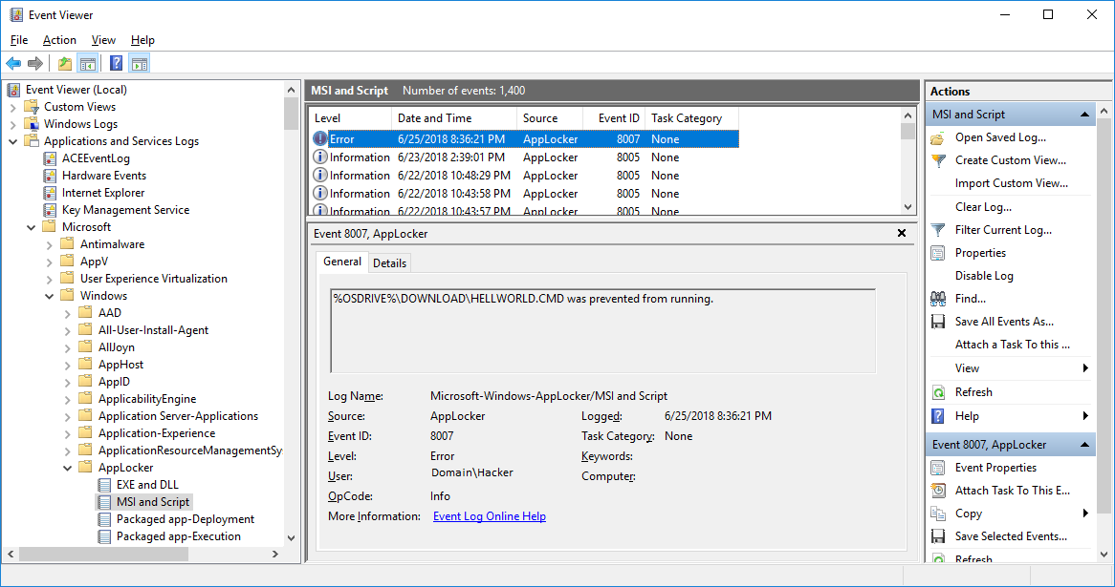
Logs

Slide 24
Recommendations/Tips
Store apps - NT AUTHORITY\SYSTEM
Writable folders under C:\Windows
AppLocker variables
DLLs

Slide 25
Challenges
Application Whitelisting and Your Managed Desktops
Types of problems we see:
“I need to log into this webinar now!”
Errors while installing applications
“Issued To” certificate attribute changes
AppLocker rule limitations
Constrained Language Mode in PowerShell

Slide 26
Questions?
Application Whitelisting and Your Managed Desktops
Jeremy Paje
Manager, Desktop Support Services
Office of Information Technology
jpaje@uci.edu
Aakash Shah
Systems Engineer, Windows Services Group
Office of Information Technology
aakash.shah@uci.edu
Click Here To Audio Of This Presentation

